Slide 1
Introduction to the History and Science of Psychology
PowerPoint® Presentation
by Jim Foley
© 2013 Worth Publishers
Notes:
*

Slide 2
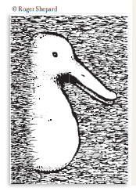
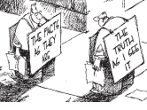
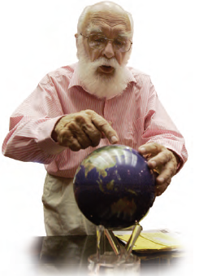
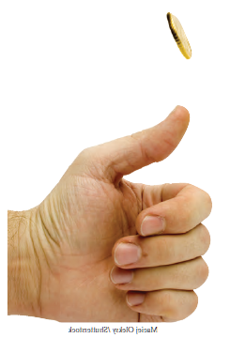
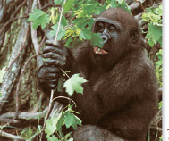
Module 2: Thinking Critically with Psychological Science
Notes:
*

Slide 3
Module 2 Topics
The need for Psychological Science: Overcoming human thinking tendencies such as:
Hindsight bias, seeing meaning in coincidences, and overconfidence error
The scientific attitude: curious, skeptical, humble
Critical Thinking
Frequently Asked Questions:
Do experiments relate to real life?
Does behavior depend on culture and gender?
How do we ethically study animals and people?
Is Psychology affected by value judgments?
Notes:
Click to reveal bullets.
*

Slide 4
“Think critically” with psychological science… does this mean “criticize”?
Why do I need to work on my thinking? Can’t you just tell me facts about psychology?
The brain is designed for surviving and reproducing, but it is not the best tool for seeing ‘reality’ clearly.
To improve our thinking, we will learn to catch ourselves in some critical thinking errors.
Critical thinking refers to a more careful style of forming and evaluating knowledge than simply using intuition.
In addition to the scientific method, critical thinking will help us develop more effective and accurate ways to figure out what makes people do, think, and feel the things they do.
Notes:
Click to reveal two text boxes.
Instructor: A comment you could make before or after mentioning the scientific method, “Although our personal experiences give us many ideas about the people around us, psychological science will help us evaluate and test those ideas in order to have more accurate knowledge about mind, feelings, and behavior.”
In the magenta sidebar: Optional Material. Could just be part of lecture material instead. Added comments:
“We’ll see more about how our minds are not the most accurate scientific tool when we get to topics such as Memory, Sensation and Perception, and Social Thinking and Influence.”
Instructor: Although the text does not bring up the phenomenon of confirmation bias at this point, I suggest mentioning it here, because it fits well with issues and examples in this chapter.
*

Slide 5
When our natural thinking style fails:
Hindsight bias:
“I knew it all along.”
Overconfidence error:
“I am sure I am correct.”
The coincidence error, or
mistakenly perceiving order in random events:
“The dice must be fixed because you rolled three sixes in a row.”
Notes:
Click to show three circles.
Instructor: There is a series of slides explaining these concepts, not all of which are necessary.
The middle error on this slide can also be described as “mistakenly thinking that a random sequence of events is a meaningful pattern.”
*

Slide 6
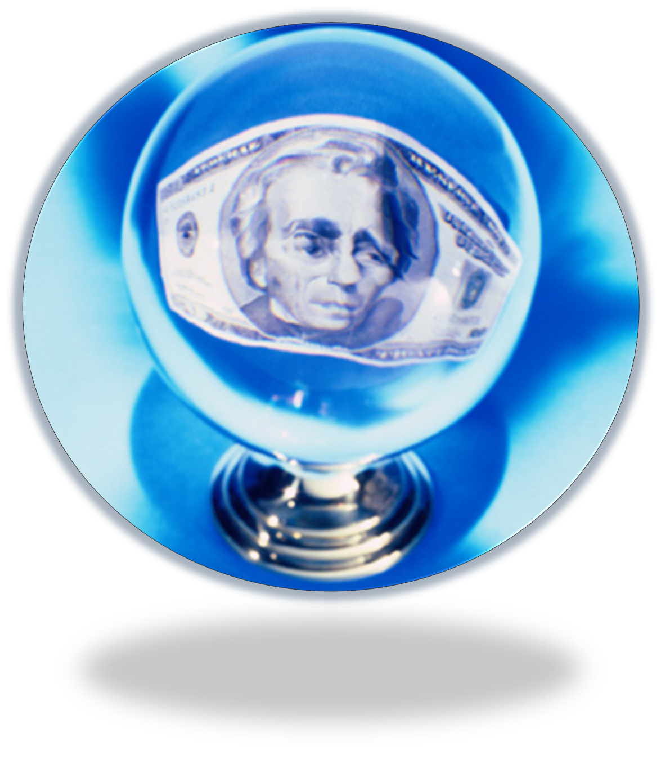
Hindsight Bias
You were accepted into this college/university
Classic example: after watching a competition (sports, cooking), if you don’t make a prediction ahead of time, you might make a “postdiction”: “I figured that team/person would win because…”
When you see most results of psychological research, you might say, “that was obvious…”
I knew this would happen…
Hindsight bias is like a crystal ball that we use to predict… the past.
Notes:
Optional slide.
Click to reveal a sequence of four “messages” in the crystal ball.
Once you saw this term explained in the book, you might have said, “I knew that’s what that meant.” However, if you haven’t done the reading, does it seem obvious?”
“ ‘that was obvious…’ This is why psychological science involves predictions, and then gathering information to test our predictions.
“Next slide: Let’s test our hindsight bias with some ’facts’….”
*

Slide 7
These sayings all seem to make sense, in hindsight, after we read them.
Absence makes the heart grow fonder
Out of sight, out of mind
You can’t teach an old dog new tricks
You’re never too old to learn
Good fences make good neighbors
No [wo]man is an island
Birds of a feather flock together
Seek and ye shall find
Opposites attract
But then why do these other phrases also seem to make sense?
Curiosity killed the cat
Look before you leap
The pen is mightier than the sword
S/He who hesitates is lost
Actions speak louder than words
The grass is always greener on the other side of the fence
There’s no place like home
Notes:
Optional slide.
Automatic animation.
Instructor: The point being made here: If students feel that the saying on one side makes intuitive sense, then when they see the opposing saying, you can show them that even opposing statements can each seem true in hindsight.
*

Slide 8
Hindsight “Bias”
Why call it “bias”?
The mind builds its current wisdom around what we have already been told. We are “biased” in favor of old information.
For example, we may stay in a bad relationship because it has lasted this far and thus was “meant to be.”
Notes:
Optional slide.
Click to reveal second graphic and text box.
Further explaining the bias: We are “biased” in favor of old information; we give old knowledge more weight than new information because we feel as if we have always known it to be correct.
Explaining the target image: Hindsight bias is like watching an arrow land and then drawing a target around it, saying “that was what we were aiming at.”
*

Slide 9
Overconfidence Error 1: Performance
Overconfidence Error 2: Accuracy
We are much too certain in our judgments.
We overestimate our performance, our rate of work, our skills, and our degree of self-control.
We overestimate the accuracy of our knowledge. People are much more certain than they are accurate.
Overconfidence is a problem in eyewitness testimony.
Overconfidence is also a problem on tests. If you feel confident that you know a concept, try explaining it to someone else.
Test for this: “how long do you think it takes you to…” (e.g. “just finish this one thing I’m doing on the computer before I get to work”)?
And your unscrambling speed?
HEGOUN
ERSEGA
Notes:
Optional slide.
Click to reveal all bullets in each column.
Instructor:
Overconfidence Error 1: The example in the text of unscrambling the anagrams is a version of “performance overestimation.”
“Still think you’d unscramble the words faster than it says in the book? And you peeked at the answer for “COSHA”? How about : HEGOUN (Enough) or “ERSEGA” (Grease)…” [I made those up, so I doubt they’ll have seen them]
Overconfidence Error 2:
Familiarity error: You may feel you know a concept from the psychology text because it looks familiar. However, then you might get surprised on the exam when it’s hard to choose between two similar answers. I suggest asking students, “do you understand?” The call on someone who nodded/raised hand to explain the concept.”
Demonstration of misjudging our accuracy: Any trivia quiz in which the answers are numbers (the diameter of the earth, the age of a famous historical figure when they died, etc.) allows you to test overconfidence; give students a chance to create a 90 percent confidence interval (90 percent sure that the correct answer is between x and y), and they may still get a lot wrong, showing overconfidence. Here’s a sample online: http://tim-richardson.net/misc/estimation_quiz.html
*

Slide 10
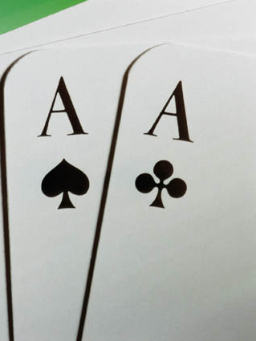
Perceiving order in random events:
Example: The coin tosses that “look wrong” if there are five heads in a row.
Danger: thinking you can make a prediction from a random series. If the ball in the roulette wheel has landed on an even number four times in a row, it does not increase the likelihood that it will land on an odd number on the next spin.
Why this error happens: because we have the wrong idea about what randomness looks like.
If 60 pieces of candy were randomly distributed to 55 students, what is the most likely number of pieces a student could expect to receive? What is the highest number of pieces someone would be likely to get?
Another type of this error: reacting to coincidence as if it has meaning
If one poker player at a table got pocket aces twice in a row, is the game rigged?
Notes:
Optional slide.
Click through examples and answers.
I have called this the “coincidence error” on another slide: the error of assuming that there is some meaning in someone winning two lotteries in one day. That error applies more to the example two slides after this one.
Explaining the author’s term: The word “perceiving” is used to highlight that it is a perception, not necessarily an accurate view of reality; you PERCEIVE that the order is there in the randomness.
About expecting an odd after 4 evens, Key insight: events based on luck do not even out, but over a zillion coin flips, they average out (become close to 50-50).
Candy example: Students may assume that most people will get one piece, but if the method is truly random, starting fresh after each piece (with names that go back into the hat after being selected), the most common number might be zero, with lots of 1’s, 2’s, even someone with 8 or more.
Poker example: “No, it has to happen sometime for some player, at some table; if everyone gets the same number of AA’s then the game must be rigged. Or, if you had been able to predict in advance which player got the AA/AA, then you might be accused of being the one cheating.”
One more example: Your dream tonight might not come true tomorrow. However, simply by chance, it is certain that someone’s dream, sometime this year, sometime in the world, will come true. If it’s “one chance in a billion,” this is 2000 times a year (365 days x 7 [billion]), somewhere in the world.
*

Slide 11
Why do we make these errors and overuse our intuition? From an evolutionary perspective:
Hindsight bias
might be an offshoot of our useful habit of analyzing an event and trying to figure out why it occurred.
Overconfidence error
might help us lead other people; certainty builds confidence in followers more than accuracy does.
Perceiving order helps us make predictions; we just need to test these and not overdo it.
Sometimes our intuition gives the right answer, which makes us trust it even more.
Notes:
This slide follows up from the first slide on these three topics, but this slide also is optional.
Click to show three circles and text.
The three circles explain these “errors” from an evolutionary perspective; however, the text that follows is a behaviorist perspective…that our use of intuition gets positively reinforced.
*

Slide 12
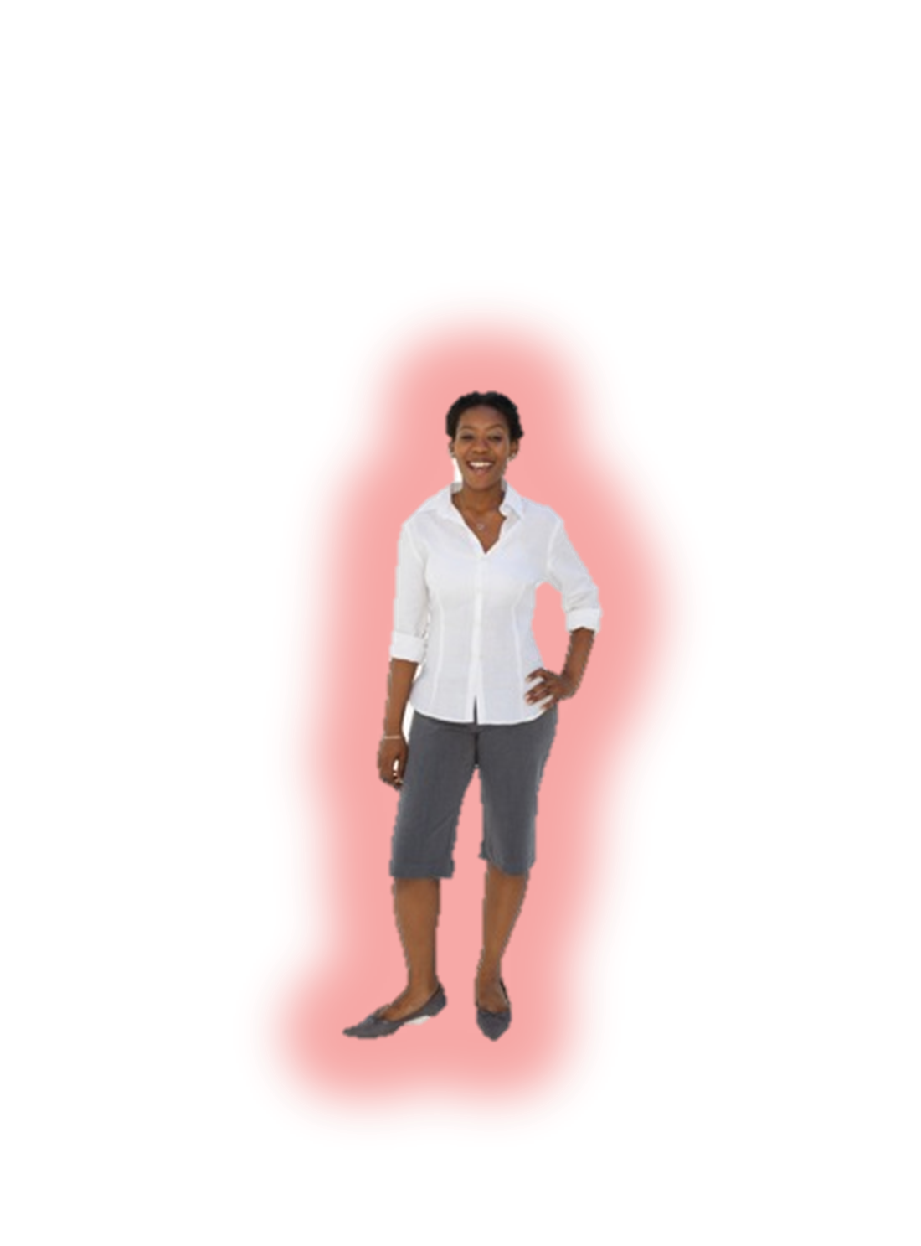
Making our ideas more accurate by being scientific
What did “Amazing Randi” do about the claim of seeing auras? He developed a testable prediction, which would support the theory if it succeeded.
Which it did not.
The aura-readers were unable to locate the aura around Randi’s body without seeing Randi’s body itself, so their claim was not supported.
Notes:
Click through to demonstrate “seeing and aura” when a face is covered and when a body is covered.
Randi’s prediction: “If you can see my aura, then you should be able to identify my location even if my body is concealed.”
The aura-readers were unable to locate the aura around Randi’s body without seeing Randi’s body itself, so their claim was not supported.
Randi shows here how to apply the scientific method to serve a part of the scientific attitude we’ll refer to in a moment: skepticism.
*

Slide 13
Okay, how do I go about being scientific?
Is there math? Test tubes?
You’ll need to be systematic.
But to guide you, you’ll need a scientific ATTITUDE.
Notes:
Optional slide, introducing the upcoming concept
Automatic animation.
Being systematic: to observe the world in a controlled way so that the information you collect will find out something clear and specific that might be true about people in general.
*

Slide 14
Scientific Attitude Part 1: Curiosity
Definition:
always asking new questions
“That behavior I’m noticing in that guy… is that common to all people? Or is it more common when under stress? Or only common for males?”
Hypothesis: Curiosity, if not guided by caution, can lead to the death of felines and perhaps humans.
Notes:
Click through to reveal all text boxes.
More thoughts and questions that might emerge from curiosity:
guessing at WHY something happens.
wondering if two events or traits tend to go together, or even one causes the other.
wondering if there are predictable patterns in people’s behavior or traits.
Comment you can add: “These guesses and wonderings sometimes take the form of ‘hypotheses,’ such as: “Curiosity, if not guided by caution, can lead to the death of felines and perhaps humans.” The hypothesis refers to “curiosity killed the cat.” The human example: “what could possibly go wrong?”
*

Slide 15
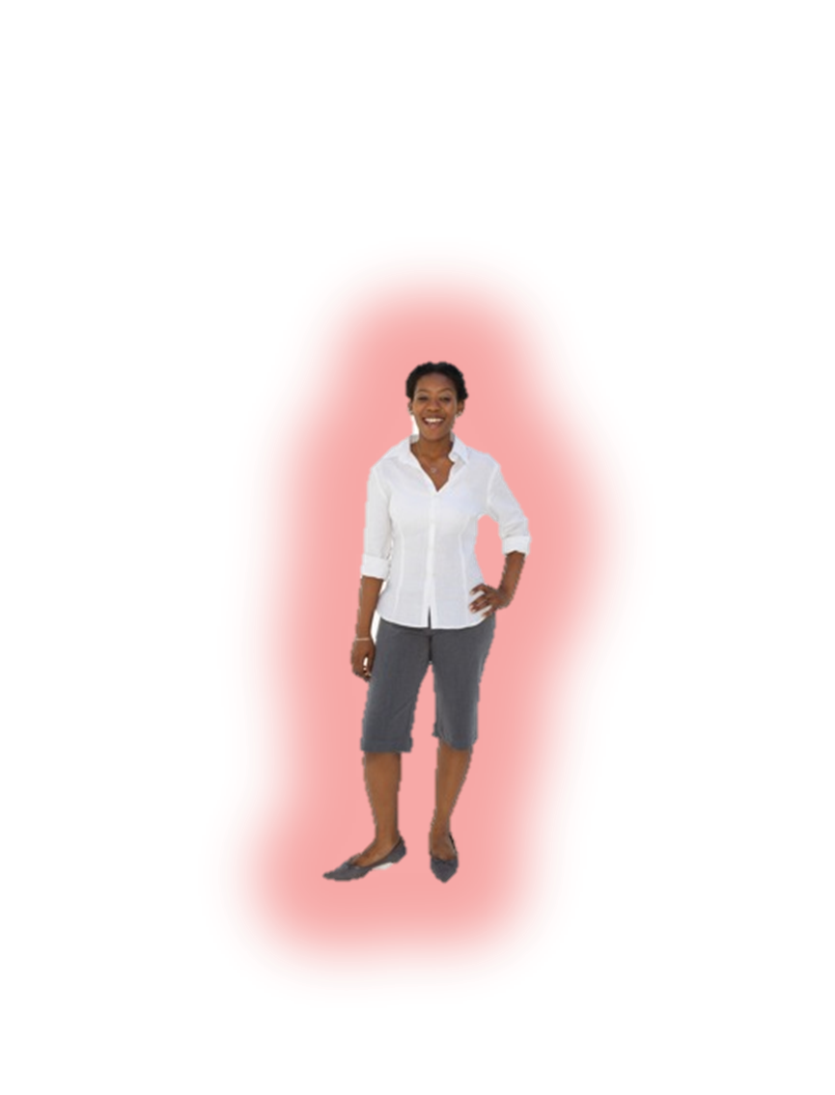
Scientific Attitude Part 2: Skepticism
Definition:
not accepting a ‘fact’ as true without challenging it; seeing if ‘facts’ can withstand attempts to disprove them
Skepticism, like curiosity, generates questions: “Is there another explanation for the behavior I am seeing? Is there a problem with how I measured it, or how I set up my experiment? Do I need to change my theory to fit the evidence?”
Notes:
Click through to reveal text boxes.
Instructor:
The Amazing Randi is of course an example of a skeptic; he didn’t just accept confirming evidence but thought of a situation which might really test whether people could see auras.
*

Slide 16
Scientific Attitude Part 3: Humility
Humility refers to
seeking the truth rather than trying to be right; a scientist needs to be able to accept being wrong.
“What matters is not my opinion or yours, but the truth nature reveals in response to our questioning.” David Myers
Notes:
Click through to reveal text boxes.
Instructor: Scientists put all three traits together when they doubt and challenge their own theories.
Some of the enemies of humility are overconfidence, confirmation bias, and belief perseverance.
*

Slide 17
Look for hidden assumptions and decide if you agree.
Consider if there are other possible explanations for the facts or results.
Look for hidden bias, politics, values, or personal connections.
Critical thinking: analyzing information to decide if it makes sense, rather than simply accepting it. Goal: getting at the truth, even if it means putting aside your own ideas.
See if there was a flaw in how the information was collected.
Put aside your own assumptions and biases, and look at the evidence.
Notes:
Click to reveal five circles.
*

Slide 18
FAQ about Psychology
Laboratory vs. Life
Question: How can a result from an experiment, possibly simplified and performed in a laboratory, give us any insight into real life?
Answer: By isolating variables and studying them carefully, we can discover general principles that might apply to all people.
Diversity
Question: Do the insights from research really apply to all people, or do the factors of culture and gender override these “general” principles of behavior?
Answer: Research can discover human universals AND study how culture and gender influence behavior. However, we must be careful not to generalize too much from studies done with subjects who do not represent the general population.
Notes:
Click to reveal each question and answer.
Re: Diversity: There may be many human universals, but it is hard to be sure we have found them when so many studies in psychology are based on the responses of largely upper-middle-class, mostly white, 18-22 year olds.
*

Slide 19
FAQ about Psychology
Ethics
Question: Why study animals? Is it possible to protect the safety and dignity of animal research subjects?
Answer: Sometimes, biologically related creatures are less complex than humans and thus easier to study. In some cases, harm to animals generates important insights to help all creatures. The value of animal research remains extremely controversial.
Ethics
Question: How do we protect the safety and dignity of human subjects?
Answer: People in experiments may experience discomfort; deceiving people sometimes yields insights into human behavior. Human research subjects are supposedly protected by guidelines for non-harmful treatment, confidentiality, informed consent, and debriefing (explaining the purpose of the study).
Notes:
Click to reveal each question and answer.
*

Slide 20
FAQ about Psychology
The impact of Values
Question: How do the values of psychologists affect their work? Is it possible to perform value-free research?
Answer: Researchers’ values affect their choices of topics, their interpretations, their labels for what they see, and the advice they generate from their results. Value-free research remains an impossible ideal.
Notes:
Click to reveal each question and answer.
*

