Slide 1
The Biology of Mind
PowerPoint® Presentation
by Jim Foley
© 2013 Worth Publishers
Notes:
*

Slide 2
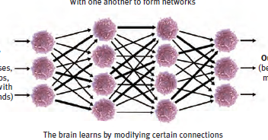
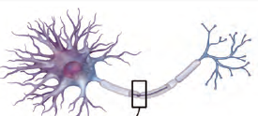
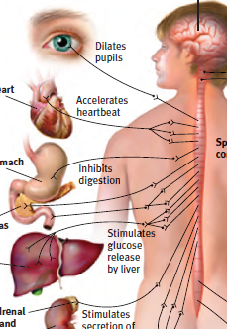
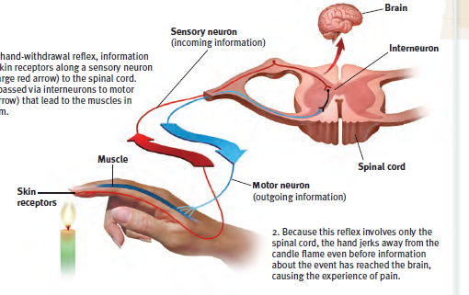
Module 4: Neural and Hormonal Systems
Notes:
*

Slide 3
Overview: What We Have in Mind
Building blocks of mind: Neurons and how they communicate (neurotransmitters)
Systems that build the mind: Functions of Parts of the Nervous system
Supporting player: the slower-communicating Endocrine system (hormones)
Notes:
No animation.
*

Slide 4
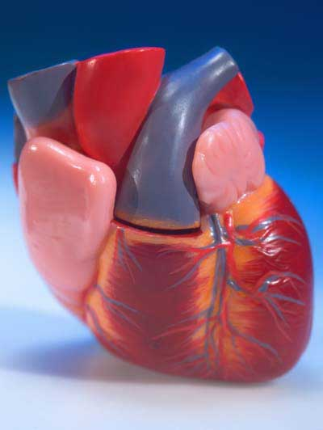
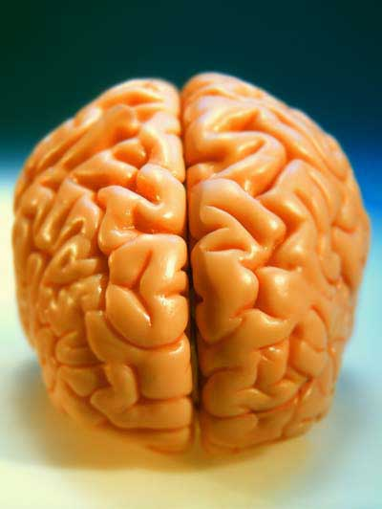
Searching for the biology of “self”
Is our identity in the heart? In the brain? In the whole body?
*
Notes:
No animation.
Lesson to bring out here: the brain is not a computer, or a mind, or identity which is separate from the rest of the body; it is all interconnected, as we soon shall see.
*

Slide 5
Searching for the self by studying the body Phrenology
Phrenology
(developed by Franz Gall in the early 1800’s):
the study of bumps on the skull and their relationship to mental abilities and character traits
Phrenology yielded one big idea--that the brain might have different areas that do different things (localization of function).
Notes:
Click to reveal additional text.
*

Slide 6
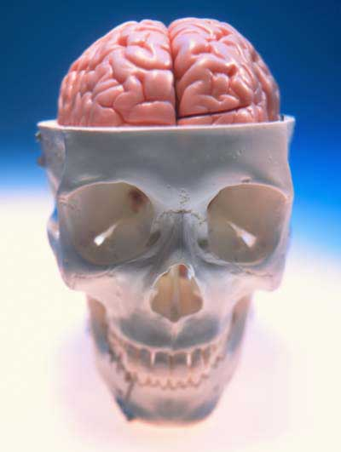
Today’s search for the biology of the self: biological psychology
Biological psychology includes neuroscience, behavior genetics, neuropsychology, and evolutionary psychology.
All of these subspecialties explore different aspects of: how the nature of mind and behavior is rooted in our biological heritage.
Our study of the biology of the mind begins with the “atoms” of the mind: neurons.
Notes:
Click to reveal bullets.
*

Slide 7
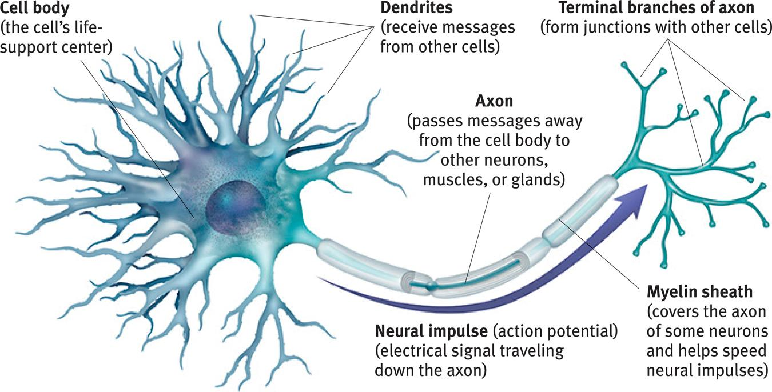
Neurons and Neuronal Communication: The Structure of a Neuron
There are billions of neurons
(nerve cells) throughout the body.
Notes:
No animation.
Most of the neurons are in the brain but there are motor and sensory neurons throughout the body. The message does not travel down the axon in the same way an electrical signal does down a wire; in fact electricity in a wire travels 3 million times faster. In the body, neural signals travel about 2 to 180 miles per hour. However, the chemical signal has an advantage; it does not decrease in intensity as it travels down the axon. No signal is lost.
You could demonstrate speed of signal transmission by having it travel across all the students hand to brain to hand across the room (or hand to shoulder to possibly bypass the brain).
Note the myelin sheath. Multiple sclerosis involves the degeneration of this layer, thus interfering with neural communication with muscles and other areas.
*

Slide 8
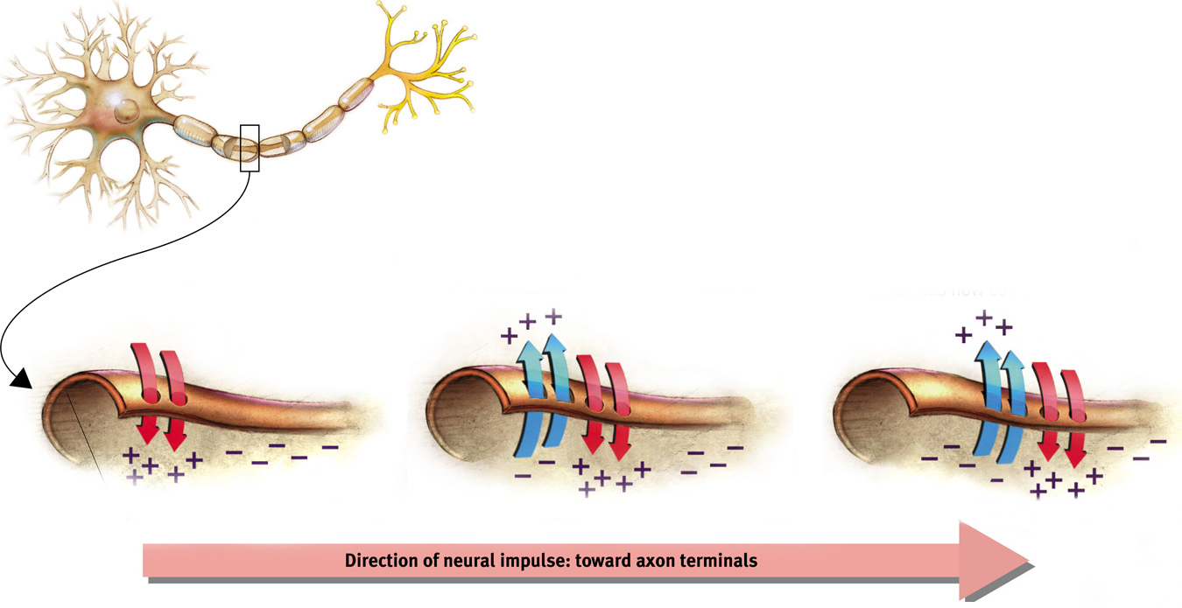
Action potential: a neural impulse that travels down an axon like a wave
Just as “the wave” can flow to the right in a stadium even though the people only move up and down, a wave moves down an axon although it is only made up of ion exchanges moving in and out.
Notes:
Automatic animation.
Note: with both the stadium example and the action potential example, no physical object actually flows in any direction when the wave flows.
The action potential is the area that is briefly charged by the net intake of positive ions; this is the traveling “electrical charge” created when channels in the cell membrane quickly allow positive ions in, and then more slowly pump the ions out again as the wave moves on.
The fans in the stadium create the wave by standing up briefly; the cell membrane creates a wave by pumping positive ions in briefly. This could be the subject of a demonstration in class.
*

Slide 9
When does the cell send the action potential?... when it reaches a threshold
How neurons communicate (with each other):
The neuron receives signals from other neurons; some are telling it to fire and some are telling it not to fire.
When the threshold is reached, the action potential starts moving.
Like a gun, it either fires or it doesn’t; more stimulation does nothing.
This is known as the “all-or-none” response.
The action potential travels down the axon from the cell body to the terminal branches.
The signal is transmitted to another cell. However, the message must find a way to cross a gap between cells. This gap is also called the synapse.
The threshold is reached when excitatory (“Fire!”) signals outweigh the inhibitory (“Don’t fire!”) signals by a certain amount.
Notes:
Click to show each stage in the path.
If signals only have one level of intensity, then why does a punch hurt more than a tap? Because in the case of the punch, more neurons are firing.
*

Slide 10
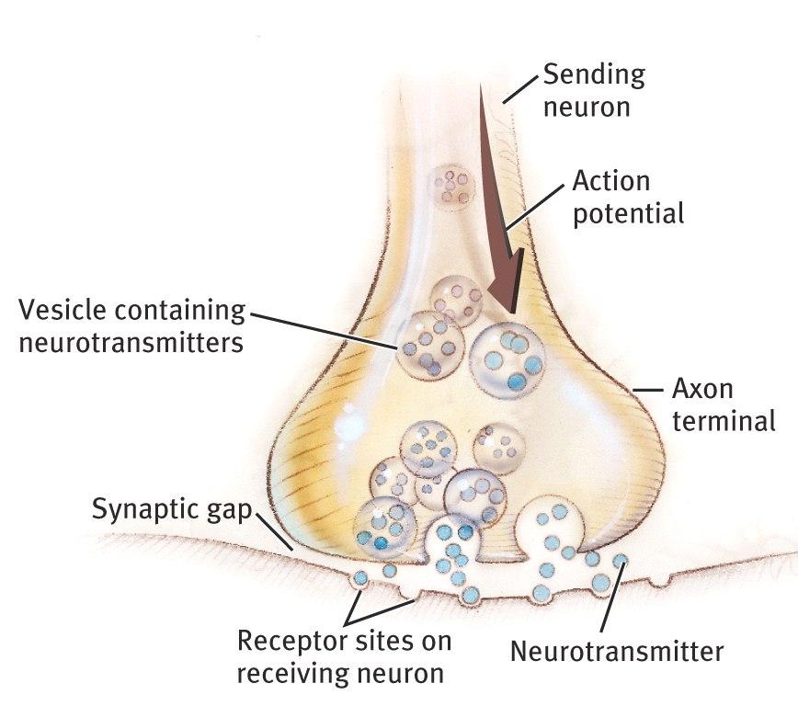
The Synapse
The synapse is a junction between the axon tip of the sending neuron and the dendrite or cell body of the receiving neuron.
The synapse is also known as the “synaptic junction” or “synaptic gap.”
Notes:
No animation.
*

Slide 11
Neurotransmitters
Neurotransmitters are chemicals used to send a signal across the synaptic gap.
Notes:
No animation.
Neurotransmitters are released from the sending neuron and stimulate receptor sites on the receiving neuron. These are the signals telling the receiving cell whether or not to fire the next action potential.
*

Slide 12
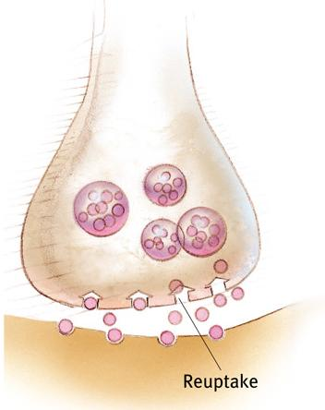
Reuptake: Recycling Neurotransmitters [NTs]
Reuptake:
After the neurotransmitters stimulate the receptors on the receiving neuron, the chemicals are taken back up into the sending neuron to be used again.
Notes:
No animation.
Reuptake ends the transmission of the signal.
Medications which inhibit this reuptake process help ensure that the signal gets transmitted. SSRIs help reduce depression by increasing serotonin levels at the synapse this way, and most ADHD medications such as Ritalin work by blocking the transport of dopamine back into the sending neuron.
*

Slide 13
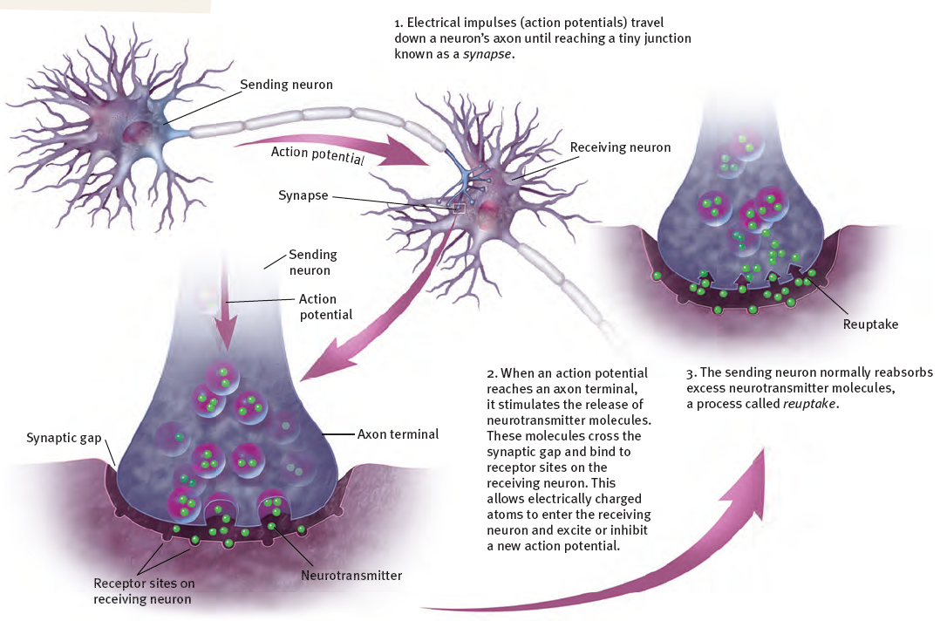
Seeing all the Steps Together
Neural Communication:
Notes:
No animation.
*

Slide 14
Roles of Different Neurotransmitters
Some Neurotransmitters and Their Functions
Neurotransmitter
Function
Problems Caused by Imbalances
Serotonin
Affects mood, hunger, sleep, and arousal
Undersupply linked to depression; some antidepressant drugs raise serotonin levels
Dopamine
Influences movement, learning, attention, and emotion
Oversupply linked to schizophrenia; undersupply linked to tremors and decreased mobility in Parkinson’s disease and ADHD
Acetylcholine (ACh)
Enables muscle action, learning, and memory
ACh-producing neurons deteriorate as Alzheimer’s disease progresses
Norepinephrine
Helps control alertness and arousal
Undersupply can depress mood and cause ADHD-like attention problems
GABA (gamma-aminobutyric acid
A major inhibitory neurotransmitter
Undersupply linked to seizures, tremors, and insomnia
Glutamate
A major excitatory neurotransmitter; involved in memory
Oversupply can overstimulate the brain, producing migraines or seizures; this is why some people avoid MSG (monosodium glutamate) in food
Notes:
Click to reveal row.
There are some uses/functions that are not mentioned, such as the role of inadequate norepinephrine and dopamine in ADHD.
Note: Some antidepressants, by blocking reuptake of serotonin, raise serotonin levels at the synapse; they don’t add more serotonin to the body.
The problem in schizophrenia may actually be an overabundance of dopamine receptors, not just an oversupply of dopamine itself.
*

Slide 15
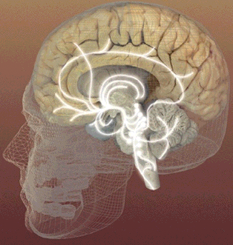
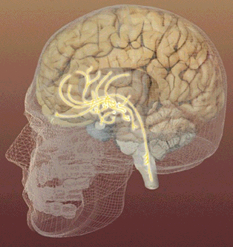
Serotonin pathways
Dopamine pathways
Networks of neurons that communicate with serotonin help regulate mood.
Networks of neurons that communicate with dopamine are involved in focusing attention and controlling movement.
Notes:
No animation.
*

Slide 16
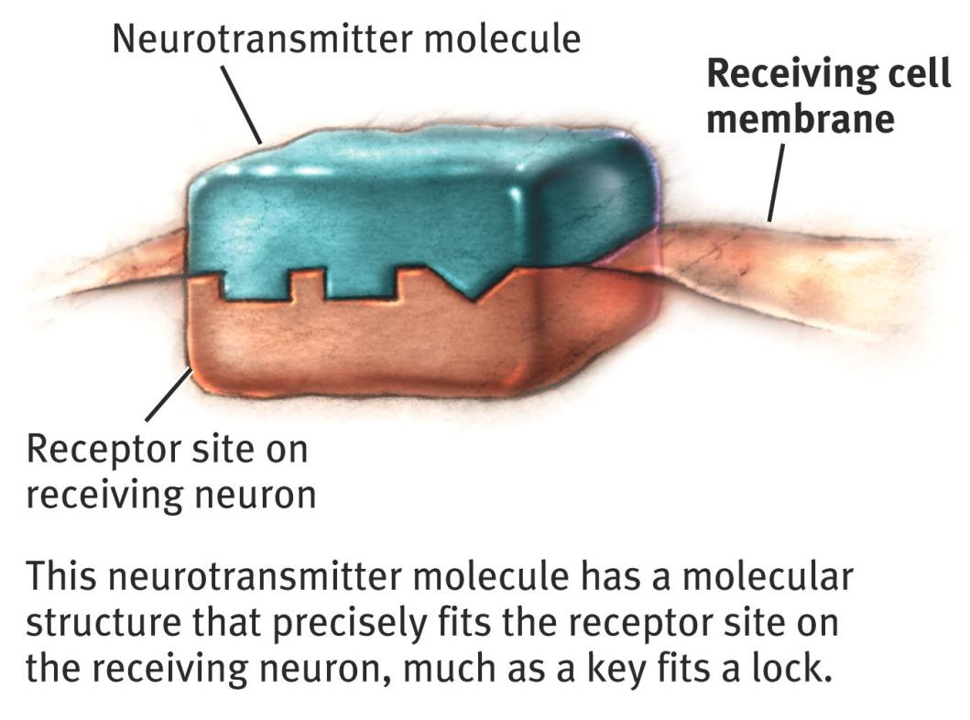
Hearing the message How Neurotransmitters Activate Receptors
When the key fits, the site is opened.
Notes:
No animation.
*

Slide 17
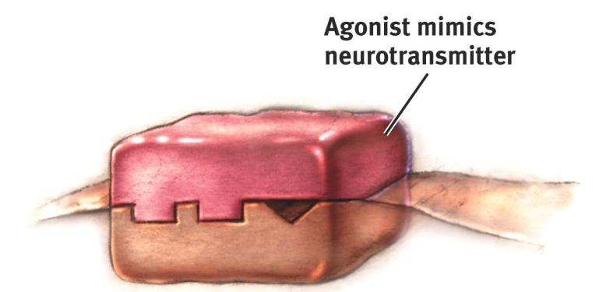
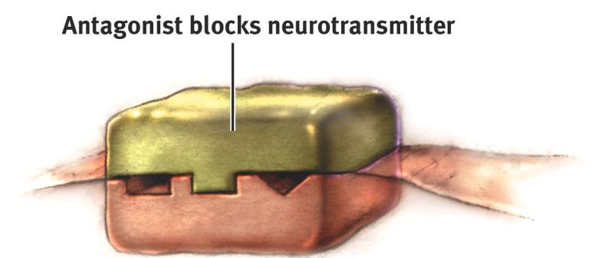
Keys that almost fit: Agonist and Antagonist Molecules
An agonist molecule fills the receptor site and activates it, acting like the neurotransmitter.
An antagonist molecule fills the lock so that the neurotransmitter cannot get in and activate the receptor site.
Notes:
No animation.
Examples you can use to test your students: pausing for the blanks below so students can fill in the correct term:
Opiate drugs stimulate the opiate receptors that are otherwise stimulated by endorphins to reduce pain. These drugs are opiate ______ (agonists).
Curare causes paralysis by blocking the acetlycholine (ACh) receptors on motor neurons; curare is an ACh _______ (antagonist).
*

Slide 18
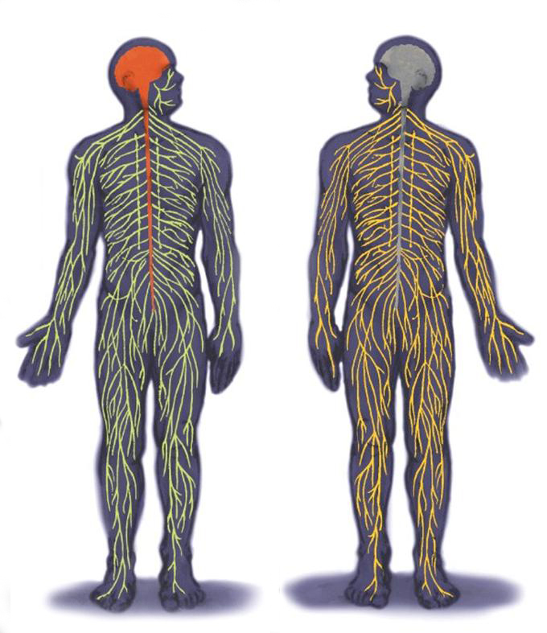
The Inner and Outer Parts of the Nervous System
The peripheral nervous system [PNS] consists of ‘the rest’ of the nervous system.
The PNS gathers and sends information to and from the rest of the body.
The central nervous system [CNS] consists of the brain and spinal cord.
The CNS makes decisions for the body.
Notes:
No animation.
The descriptive text is color-coded to go with the part of the nervous system referred to in the diagram.
The image is from a previous version of the text.
*

Slide 19
Types of Neurons
Sensory neurons carry messages IN from the body’s tissues and sensory receptors to the CNS for processing.
Motor neurons carry instructions OUT from the CNS out to the body’s tissues.
Interneurons (in the brain and spinal cord) process information between the sensory input and motor output.
Notes:
Automatic animation.
There are millions of sensory neurons and millions of motor neurons, but BILLIONS of interneurons.
*

Slide 20
The “Nerves” are not the same as neurons.
Nerves consist of neural “cables” containing many axons.
Nerves are part of the peripheral nervous system and connect muscles, glands, and sense organs to the central nervous system.
Notes:
Click to reveal two sentences.
*

Slide 21
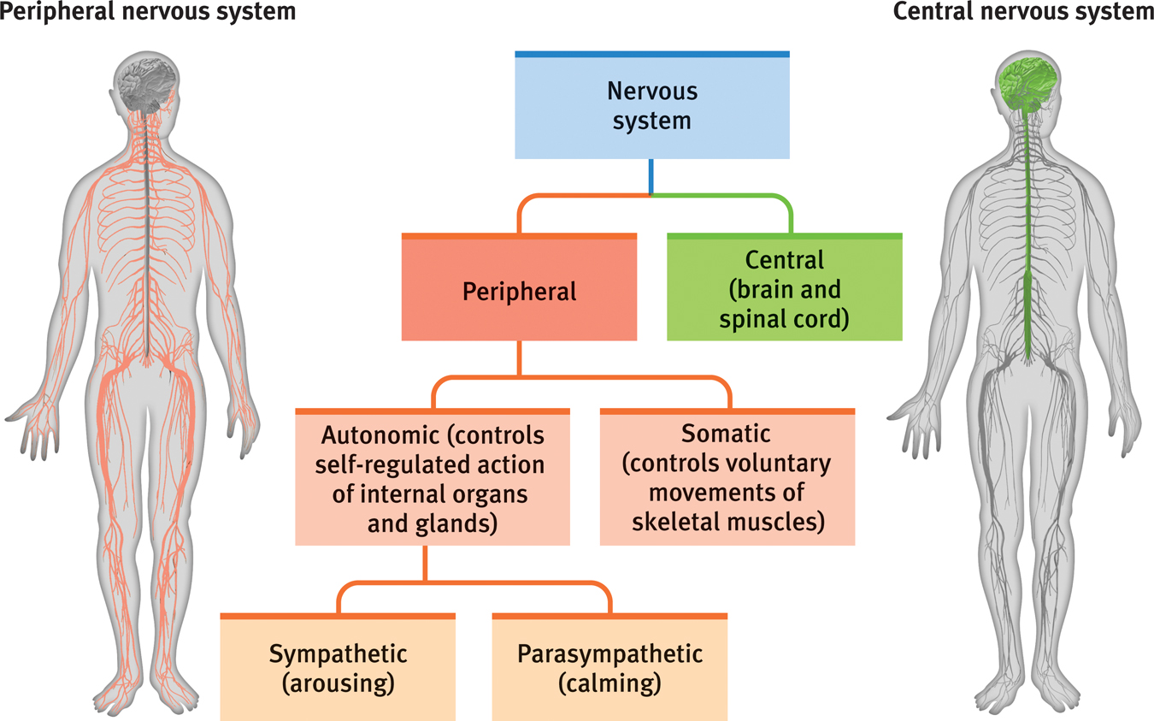
More Parts of the Nervous System
Notes:
No animation.
Note that the autonomic, somatic, sympathetic, and parasympathetic branches of the nervous system are all part of the PNS.
*

Slide 22
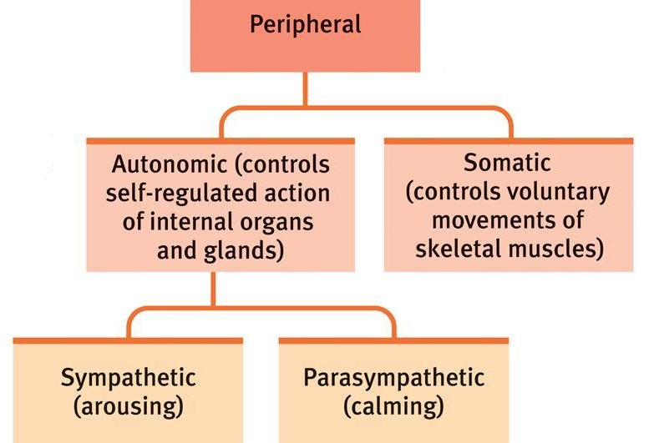
The Peripheral Nervous System
Notes:
No animation.
*

Slide 23
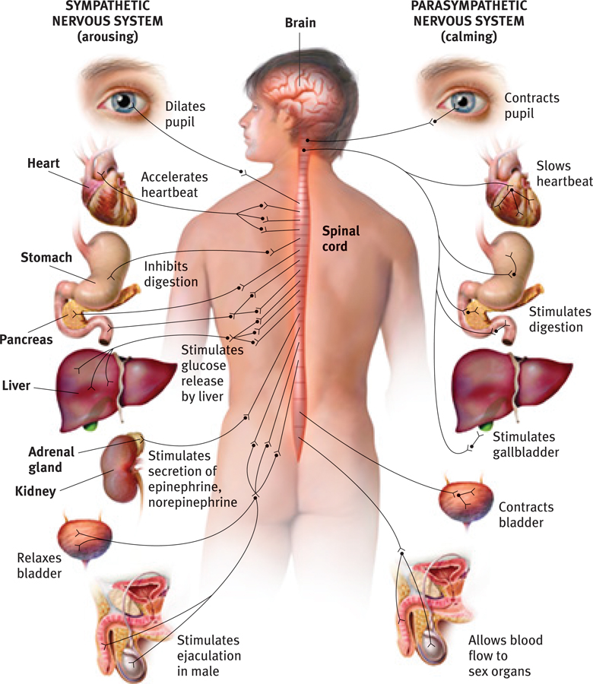
The Autonomic Nervous System:
The sympathetic NS arouses (fight-or-flight) The parasympathetic NS calms (rest and digest)
Notes:
No animation. 1. Question to ask students: Why not just stay aroused all the time?...to allow the body to repair itself and regain energy from food.
2. Comment to students: note the sympathetic nervous system’s effect on the stomach and bladder., This helps us understand why “I was so upset that I wet my pants” or “I was so upset I threw up.” Now you can take these reports as a sign of strong activation of the sympathetic part of the autonomic nervous system.
*

Slide 24
The Central Nervous System
The brain is a web of neural networks.
The spinal cord is full of interneurons that sometimes have a “mind of their own.”
Notes:
Click to reveal bullets.
*

Slide 25
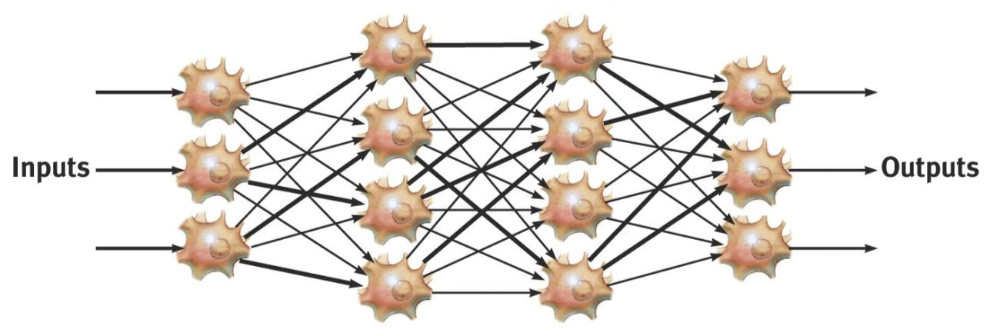
Neural Networks
These complex webs of interconnected neurons form with experience.
Remember:
“Neurons that fire together, wire together.”
Notes:
No animation.
These neural networks are activated when needed for action.
*

Slide 26
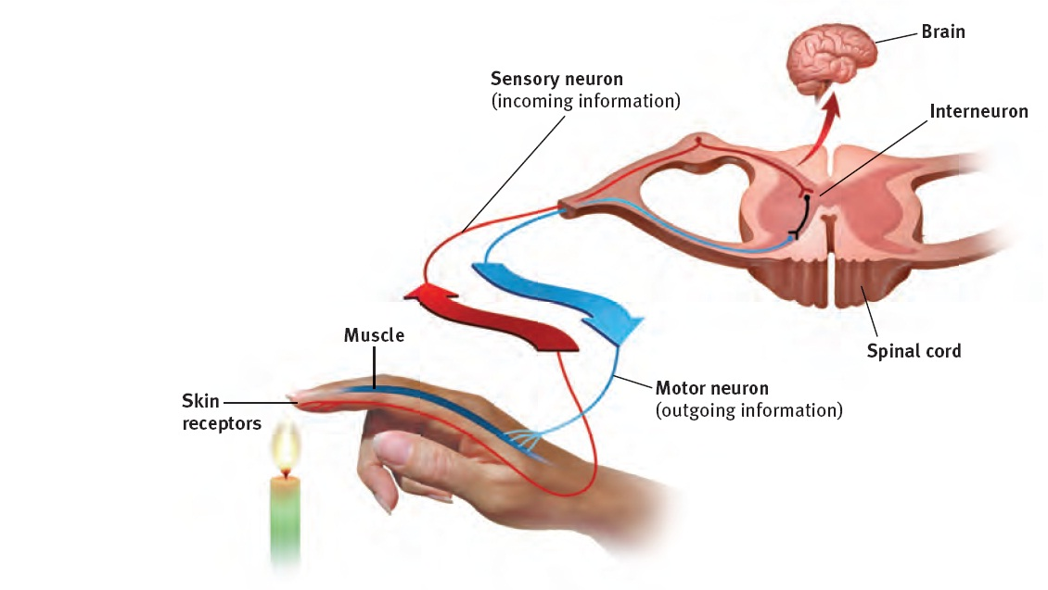
Interneurons in the Spine
Your spine’s interneurons trigger your hand to pull away from a fire before you can say OUCH!
This is an example of a reflex action.
Notes:
No animation.
You not only won’t have time to say “ouch,” you won’t even think it. This is because before the brain gets the pain message, the interneurons in the spinal cord are already sending a message back through motor neurons saying, “pull your hand away!”
*

Slide 27
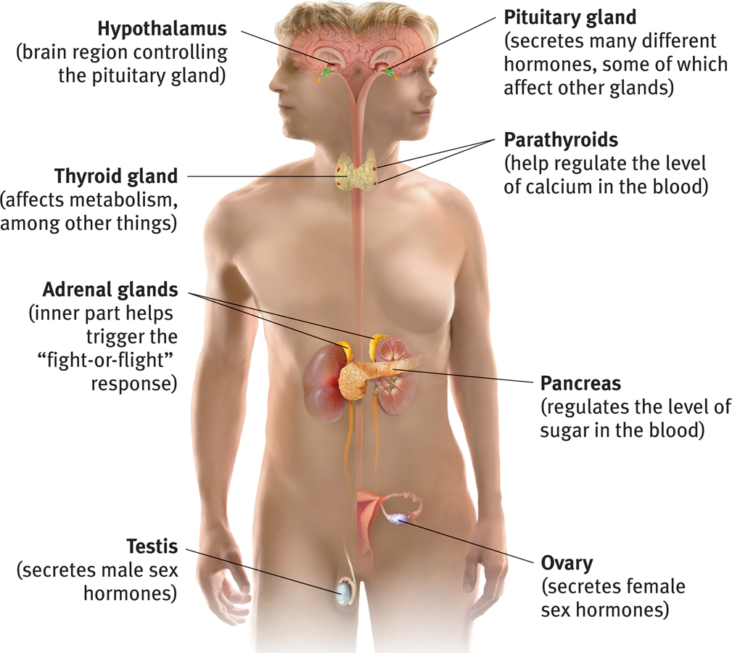
The Endocrine System
The endocrine system refers to a set of glands that produce chemical messengers called hormones.
Notes:
No animation.
Instead of sending messages across the synapse, the endocrine system sends messages through the bloodstream. The nervous system and the endocrine systems are connected and influence each other. Endocrine system messages travel more slowly but also last longer.
*

Slide 28
The Body’s “Slow but Sure” Endocrine Message System
The endocrine system sends molecules as messages, just like the nervous system, but it sends them through the bloodstream instead of across synapses.
These molecules, called hormones, are produced in various glands around the body.
The messages go to the brain and other tissues.
Notes:
Click to reveal bullets.
“Slow but sure” endocrine system messages take longer to get to their location, but then the molecules hang around for a bit, so the effect of the “message” lasts longer. In neural communication, reuptake of the neurotransmitters sometimes prevents effective communication. (This is the real “chemical imbalance” treated by some medication: slowing reuptake.)
*

Slide 29
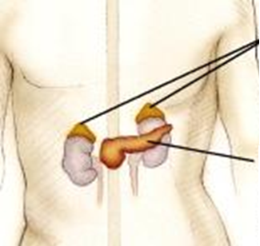
Adrenal Glands
produce hormones such as adrenaline/epinephrine, noradrenaline/norepinephrine, and cortisol.
Adrenal Glands
The sympathetic “fight or flight” nervous system responds to stress by sending a message to adrenal glands to release the hormones listed above.
Effect: increased heart rate, blood pressure, and blood sugar. These provide ENERGY for the fight or flight!
Pancreas
Notes:
Click to reveal bullets.
The adrenal glands also produce cortisol; more about this when we talk about stress and health.
*

Slide 30
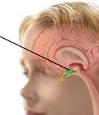
The Pituitary Gland
The pituitary gland is the “master gland” of the endocrine system.
It is controlled through the nervous system by the nearby brain area--the hypothalamus.
The pituitary gland produces hormones that regulate other glands such as the thyroid.
It also produces growth hormone (especially during sleep) and oxytocin, the “bonding” hormone.
Pituitary gland
Notes:
Click to reveal bullets.
*

