Slide 1


Consciousness
and the Two-Track Mind
PowerPoint® Presentation
by Jim Foley
© 2013 Worth Publishers

Slide 2
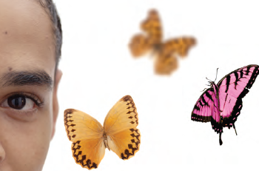
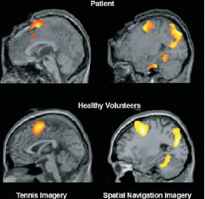

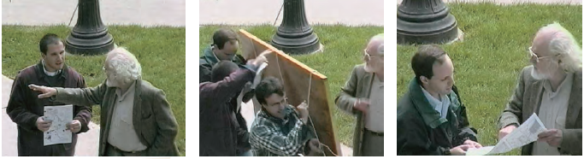
Module 7:
Brain States and Consciousness

Slide 3
Topics to be aware of:
Defining Consciousness
The Biology of Consciousness
Having a “Dual-Track” Mind
Selective Attention

Slide 4
Consciousness is…
alertness; being awake vs. being unconscious
self-awareness; the ability to think about self
having free will; being able to make a “conscious” decision
a person’s mental content, thoughts, and imaginings
To explore the nature of consciousness, it helps to first choose a definition.
In the text, consciousness is defined as:
“our awareness of ourselves and our environment.”
Aren’t animals aware of their environment?
If so, is our awareness different?...
Possibly…because we have (uniquely?) a narrative experience of that awareness.
Notes:
Click to reveal bullets and definition
Instructor: Other comments for the class or for the slide, clarifying the word “awareness” in the definition:
“seeing one’s foot (and sniffing it) may be a dog’s level of awareness.”
Humans uniquely may have a narrative experience of that awareness, with identity as part of the narrative. We can react to a noise AND tell a mental story about how we reacted, even if a strict behaviorist might see that story as irrelevant. We see the foot at the end of the bed as part of ourselves; if we had a tail, we would not chase it. People can look in a mirror and see not just a set of features but a face, a self.

Slide 5

Chapter Topics
This chapter is concerned with:
the quality our mental experience.
the role of the brain in that experience.
the way that experience is affected by the two tracks of mental experience.
the way that experience is altered by
  sleep.
  hypnosis.
  psychoactive drugs.
Notes:
You may consider this slide unnecessary if you’ve used slide #2 as an overview.
Click to reveal bullets.

Slide 6
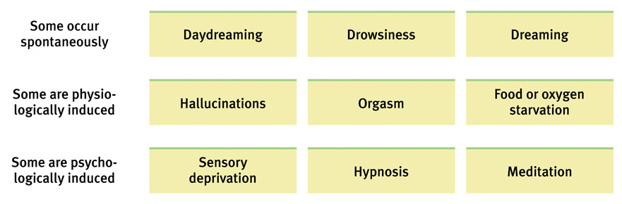
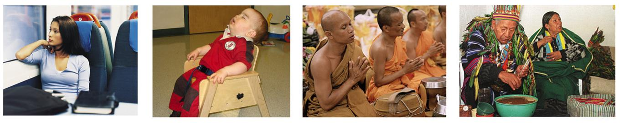
Forms of Consciousness
Notes:
No animation.
Instructor: Students can be asked, “Where in this table would you put marijuana use? Or ‘blanking out’ during trauma?”

Slide 7
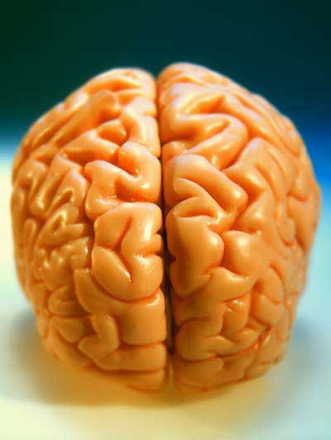
Psychology’s Relationship to this Topic
Psychology was once defined as “the description and explanation of states of consciousness.”
Now, consciousness is just one topic among many for psychologists.
Cognitive neuroscience allows us to revisit this topic and see how the brain is involved.
Notes:
No animation.

Slide 8

Brain and Consciousness:
Findings and Debates
Debate
What is going on in the brain that generates our experience of consciousness?
Finding
Some rare “unconscious” patients have brain responses to conversation.
One View
Synchronized, coordinated brain activity generates consciousness, or at least is a sign that conscious activity is occurring.
Implication
Don’t judge a book by its cover when it comes to consciousness.
Notes:
Automatic animation for “Finding” sequence, click to show “Debate” sequence.
Instructor: It is easy to draw the wrong conclusions from this finding, such as turning anecdotes into generalizations, or thinking that all unconscious patients have an inner conscious life.
Debate: This view doesn’t tell us how synchronized brain activity creates the human level of self-awareness. However, it may show when enough of the brain is involved that it may feel like a unified experience that we can notice, as opposed to “unconscious” activity such as how we position a leg movement on stairs so that our foot lands on the next step.

Slide 9
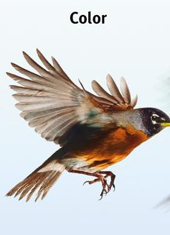
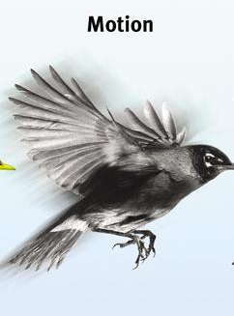
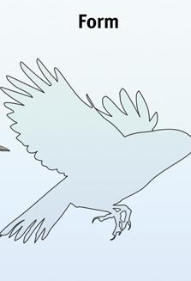
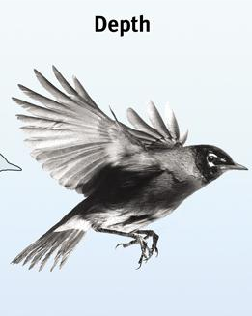
Conscious vs. Unconscious Activity:
The Dual-Track Mind
Conscious “high” track:
our minds take deliberate actions we know we are doing
Examples: problem solving, naming an object, defining a word
Unconscious “low” track:
our minds perform automatic actions, often without being aware of them
Examples: walking, acquiring phobias, processing sensory details into perceptions and memories
Example in the book (borrowed from the Sensation and Perception topic:
Automatic processing: Conscious “high” track says, “I saw a bird!”
Unconsciously, we see:
Notes:
Automatic animation for high track and low track. Click to show start of example. Click again to show the rest of the example.

Slide 10
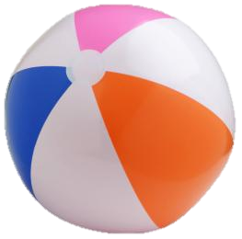
Think before you act?
In one study, students showed brain activity related to pushing a button BEFORE they were aware of their decision to push the button.
Does this mean the “decision” is an illusion?
What experiment from the beginning of the semester does this remind you of?
Why Have Two Tracks?
Possible benefit: not having to think about everything we do all at once
Examples
You can hit or catch a ball without having to consciously calculate its trajectory.
You can speak without having to think about the definitions of each word.
You can walk and chew gum AND carry on a conversation.
Notes:
Click to reveal bullets and then sidebar with bullets.
Third bullet: this is similar to Wilhelm Wundt’s experiment in the late 1800s, in which participants were quicker to push a button about seeing the ball fall than they were about being aware of hearing the ball fall. The delay is not for the same reason…hopefully this generates a good discussion, maybe even about whether free will is an illusion. However, the facts bring us back to the two-track topic; that conscious awareness of an action is not as fast a process as simply taking the action.

Slide 11

Unusual Consequences of Having a Dual-Track Mind
Blindsight
Selective
Attention
Selective Inattention
  Inattentional blindness
  Change blindness
  Choice blindness
Notes:
Click through to reveal all text boxes.

Slide 12
Blindsight
Case Study
A woman with brain damage, but NO eye damage, was unable to use her eyes to report what was in front of her.
BUT, she was able to use her eyes to help her take actions such as putting mail in slots.
  What are the two mental “tracks” in this case?
Describing the mail and the slot:
the “high road,” or conscious track, in this case known as the visual perception track
Judging size and distance well enough to put the mail in the slot:
the “low road,” or unconscious, automatic track, in this case known as the visual action track
Notes:
Click to show question after reading the case study, then click to show each track.
The high road was broken; when asked, the woman was unable to recognize, name, and discriminate between objects. However, the low road worked; when carrying out an action like putting the mail in slots, she could judge width and depth.
Question to test reading and understanding: how does the hollow face illusion (fig. 3.4 in the text) show the difference between what is going on in our visual perception and action tracks?
Answer: Our perception track makes an error about whether the face is concave or convex, but our action track gets it right, reaching in to the concave face to touch a speck on the “mask.”

Slide 13


Selective Attention
There are millions of bits of information coming at our senses every second.
So, we have the skill of selective attention; our brain is able to choose a focus and select what to notice.
Selective Attention and Conversation
The good news: we can focus our mental spotlight on a conversation even when other conversations are going on around us. This is known as the cocktail party effect.
The bad news: we can hyperfocus on a conversation while driving a car, putting the driver and passengers at risk.
Notes:
Click to reveal bullets:
Whether driving and talking, or chewing gum and walking, there is a limit to how much we can pay attention to simultaneously. Generally, this is a good thing, or we could not follow a conversation in a crowded room.
Luckily, much of driving is “low road,” automatic activity, but many decisions require actual conscious attention. Driving while talking on a cell phone has been demonstrated to be much more distracting than a conversation in a car… maybe because you’re imagining a different location?
If we have a two-track mind, is texting while driving okay, because we can do each in a separate track? How about talking on a cell phone? How about talking to someone in the car with you? Wherever you draw the line, this example brings up the fact that the two tracks are not completely separate from each other; there still is a limited (finite?) amount of attention available.

Slide 14
Selective Attention: what we focus on, what we notice
Selective Inattention:
  what we are not focused on, what we do not notice
Selective inattention refers to our failure to notice part of our environment when our attention is directed elsewhere.
Selective Inattention:
inattentional blindness
change blindness
choice blindness
Notes:
Click to reveal text boxes.

Slide 15
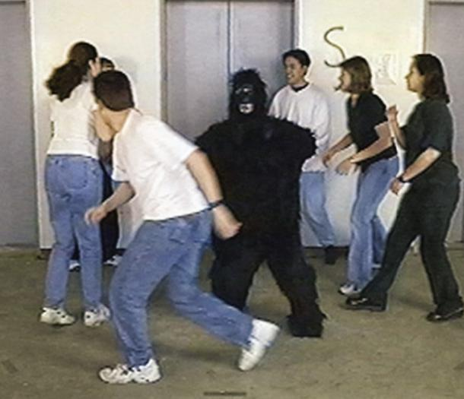
Inattentional Blindness
Various experiments show that when our attention is focused, we miss seeing what others may think is obvious to see (such as a gorilla, or a unicyclist).
Some “magic” tricks take advantage of this phenomenon.
Notes:
Click when you are ready to have the unicyclist pop out.
To the students: “You may think you would notice the gorilla in the video, but probably only if you weren’t following the directions to count all the bounce passes from the white shirted player to black shirted player.”
It is not possible to get free permission to show this particular video, but there are lots of videos on YouTube under “inattentional blindness.” My favorite: search for “color changing card trick.”

Slide 16
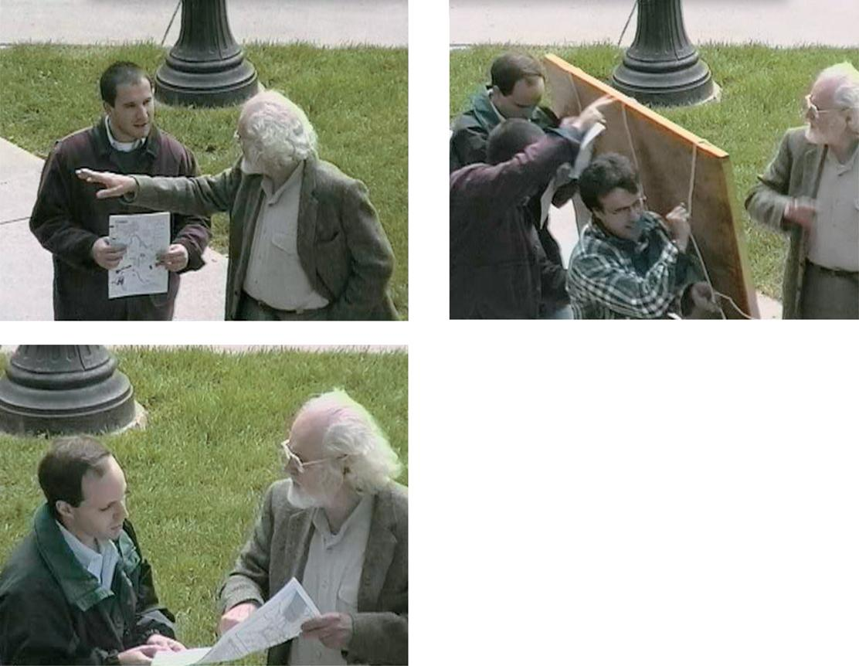
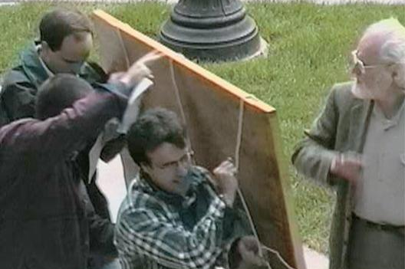
Change Blindness
The Switch
Two-thirds of people didn’t notice when the person they were giving directions to was replaced by a similar-looking person.
By the way, did you notice whether the replacement person was in the same clothes or different clothes?
Notes:
Click to fade pictures and show question.
Instructor: Pictures fade first so that you can test what students were paying attention to. Those who claim to know the answer: ask what changes they recall. Then, be sure to comment that if students don’t know what clothing changes happened, that’s a GOOD thing; it’s a sign that they were using their selective attention to notice the concepts on the slide. You could add that those who admitted not noticing were showing their ability to resist hindsight bias and the overconfidence error they learned about in the previous chapter.
Another click brings the pictures back.

Slide 17
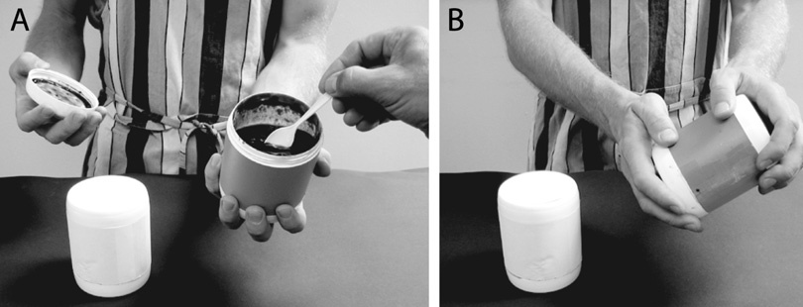
Choice Blindness
In one experiment, people chose their favorite among two jams. But when the jar’s contents were deceptively reversed and tasted again, people described the same jar’s contents as their chosen jam.
The researcher flips the divided containers, so that the next taste from that jar is actually the other jam.
Notes:
No animation.
Instructor: Discuss if this is simply an example of change blindness, or a sub-category of change blindness, or something different because of the choice involved. Because people were tested by being asked to explain their preference after the second taste, this result might be explained by cognitive dissonance.

