Slide 1
Consciousness
and the Two-Track Mind
PowerPoint® Presentation
by Jim Foley
© 2013 Worth Publishers

Slide 2
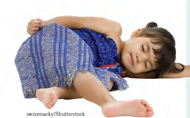
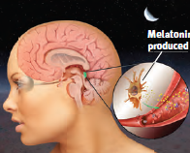
Module 8: Sleep and Dreams
Notes:
Images from pages 91, 94, 97, 108

Slide 3
Topics to dream about
Biological rhythms and sleep
Theories of why we need sleep
Sleep deprivation and sleep disorders
What and why we dream

Slide 4
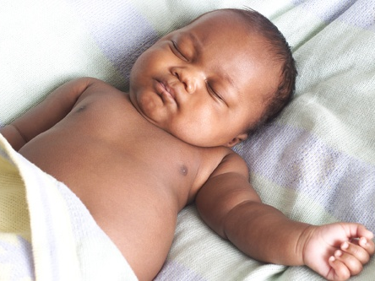
To SLEEP-- perchance, to Dream
Notes:
Automatic animation.
Pardon the misuse of a line from “Hamlet” in the slide.

Slide 5
Sleep as a State of Consciousness
How Do We Learn About Sleep and Dreams?
We can monitor EEG/brain waves and muscle movements during sleep.
We can expose the sleeping person to noise and words, and then examine the effects on the brain (waves) and mind (memory).
We can wake people and see which mental state (e.g. dreaming) goes with which brain/body state.
When sleeping, are we fully unconscious and “dead to the world”?
Or is the window to consciousness open?
Consider that:
we move around, but how do we stop ourselves from falling out of bed?
we sometimes incorporate real-world noises into our dreams.
some noises (our own baby’s cry) wake us more easily than others.
Notes:
Click to reveal all text and bullets.
Instructor: In the sidebar, the third strategy is the way in which the brain waves and eye movements of REM sleep were discovered to be associated with dreaming.

Slide 6
Sleep and Biological Rhythms
24 hour biological “clock”
90 minute sleep cycle
.
Notes:
No animation.

Slide 7
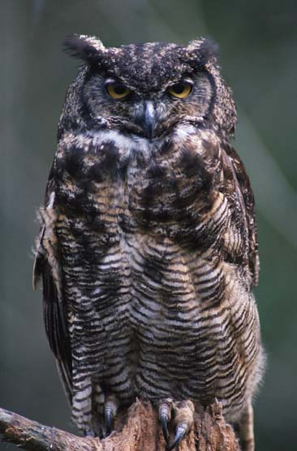
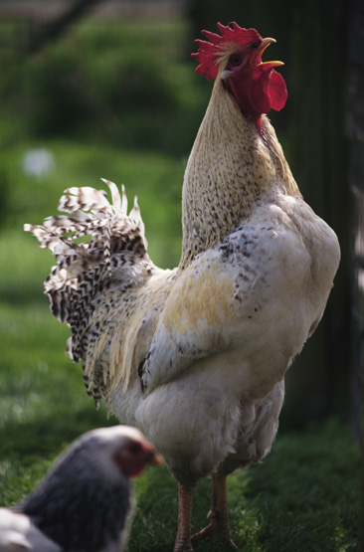
Daily Rhythms and Sleep
The circadian (“about a day”) rhythm refers to the body’s natural 24-hour cycle, roughly matched to the day/night cycle of light and dark.
“Larks” and “Owls”
Daily rhythms vary from person to person and with age.
General peaks in alertness:
evening peak—20-year old “owls”
morning peak—50-year old “larks”
What changes during the 24 hours?
Over the 24 hour cycle, the following factors vary, rising and falling over the course of the day and night:
body temperature
arousal/energy
mental sharpness
Notes:
Click to reveal all text.
Instructor: Light affects this rhythm through a process involving the brain; more about this later when we talk about WHY we sleep.

Slide 8
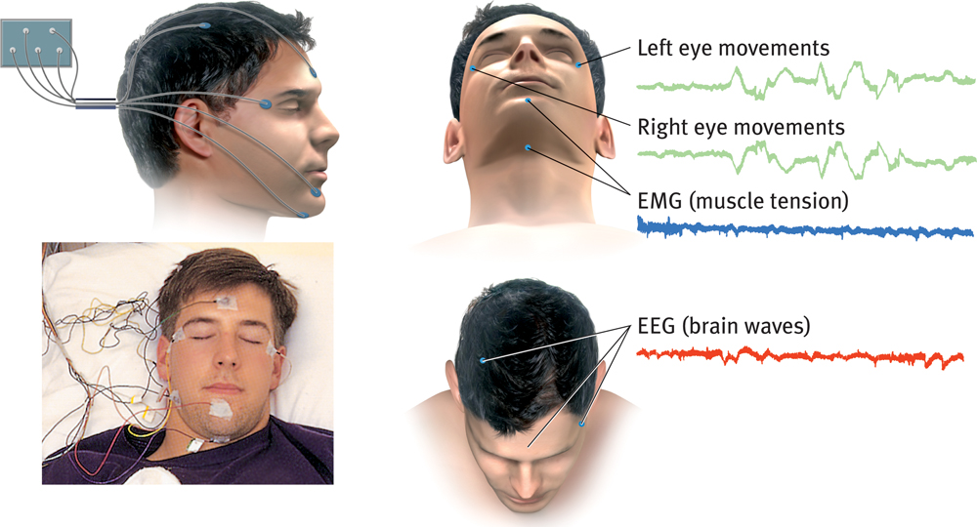
Sleep Stages and Sleep Cycles: What is Measured?
Notes:
No animation.

Slide 9
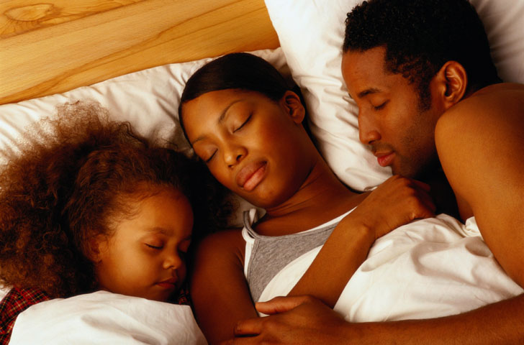
Stages and Cycles of Sleep
There are four types of sleep.
Sleep stages refer to distinct patterns of brain waves and muscle activity that are associated with different types of consciousness and sleep.
Sleep cycles refer to the patterns of shifting through all the sleep stages over the course of the night. We “cycle” through all the sleep stages in about 90 minutes on average.
Notes:
Click to reveal all text.
Next, we will learn about the various stages, and then look at the cycles of how these stages typically occur over a night’s sleep.

Slide 10
Falling Asleep: From Alert to Alpha
Eyes Closed
Alpha waves are the relatively slow brain waves of a relaxed, awake state.
Notes:
No animation.

Slide 11
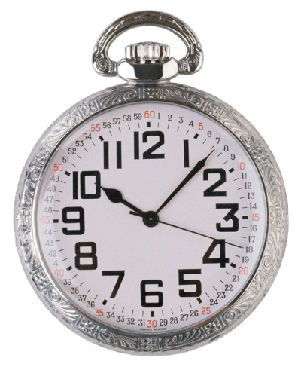
Falling asleep
Yawning creates a brief boost in alertness as your brain metabolism is slowing down.
Your breathing slows down.
Brain waves become slower and irregular.
You may have hypnagogic (while falling asleep) hallucinations.
Your brain waves change from alpha waves to NREM-1.
Notes:
Click to reveal bullets.

Slide 12
Non-REM Sleep Stages Getting deeper into sleep… but not dreaming yet
NREM-1
NREM-2
NREM-3
Notes:
On click, after you have reviewed the stages in general, the label for sleep spindles in NREM-2 will appear.
Stage two brain wave patterns have been called theta waves, and NREM-3 involves delta waves.
NREM-3 is slow wave sleep, the former stages 3 and 4 combined--deep sleep.

Slide 13
REM Sleep
What happens during REM sleep?
Eugene Aserinsky’s discovery (1953): dreams occurred during periods of wild brain activity and rapid eye movements [REM sleep].
Heart rate rises and breathing becomes rapid.
“Sleep paralysis” occurs when the brainstem blocks the motor cortex’s messages and the muscles don’t move. This is sometimes known as “paradoxical sleep”; the brain is active but the body is immobile.
Genitals are aroused (not caused by dream content) and stay this way after REM is over.
Notes:
Click to reveal bullets.
So, do we act out our dreams? Not unless you have a sleep disorder. Sleepwalking doesn’t usually occur during REM sleep, unless you have a sleep disorder (or have rare reactions to some sleep-inducing medications).

Slide 14
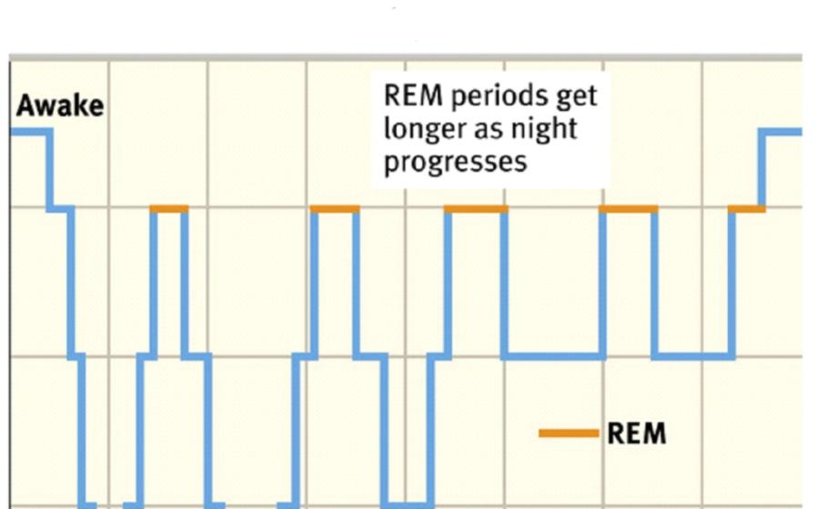
Stages of Sleep: The 90 Minute Cycles Through 8 Hours of Sleep
The length of REM sleep increases the longer you remain asleep.
With age, there are more awakenings and less deep sleep.
NREM-1
NREM-2
NREM-3
Notes:
No animation.

Slide 15
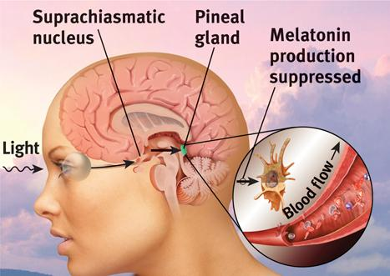
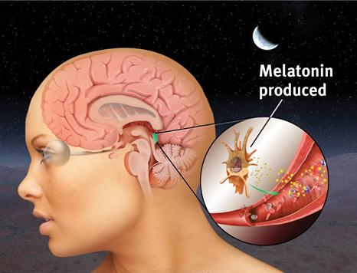
Why do we sleep? What determines the quantity and rhythm of sleep?
The amount and pattern of sleep is affected by biology, age, culture, and individual variation.
Age: in general, newborns need 16 hours of sleep, while adults need 8 hours or less
Individual (genetic) variation: some people function best with 6 hours of sleep, others with 9 hours or more
Culture: North Americans sleep less than others, and less than they used to, perhaps because of the use of light bulbs
Light and the brain regulate sleep.
The circadian rhythm is hard to shift (jet lag).
This rhythm can be affected by light, which suppresses the relaxing hormone melatonin.
Notes:
Click to reveal bullets.
Jet lag, and the tough time getting up the first day of work after a vacation, are caused by the way our body clock stays set.
Rather than take melatonin supplements to get sleepy, you can raise your levels of melatonin just by turning lights down low for an hour or so before going to bed. Note: this brain/hormone information is not in this edition of the text, so you may want to delete this information.

Slide 16
Why do we sleep? What does sleep do for us?
Sleep protected our ancestors from predators.
Sleep restores and repairs the brain and body.
Sleep builds and strengthens memories.
Sleep facilitates creative problem solving.
Sleep is the time when growth hormones are active.
Notes:
Click to reveal bullets.
More details on each of the above points:
Small, defenseless animals hide and sleep a lot, often feeding at night when predators can’t see them as well. Animals too large to hide and be protected by sleep may have evolved to sleep very little.
Regarding the animal sleep chart: notice that the animals who burn a lot of calories, generating free radicals, need sleep to repair tissue.
3) Not only does sleep allow recent memories to become strengthened, but the connections we are not using get pruned. During sleep, no new interfering information is introduced.
4) Sleep is the ultimate incubation period for problem solving, regardless of whether we get ideas in our dreams.
6) Growth hormones are also important for muscle development.

Slide 17
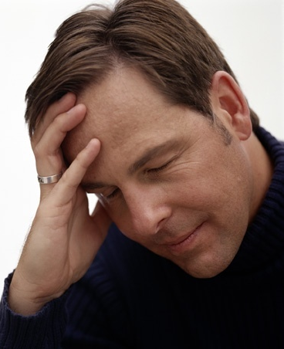
Effects of Sleep Loss/ Deprivation
Research shows that inadequate sleep can make you more likely to:
lose brainpower.
gain weight.
get sick.
be irritable.
feel old.
Notes:
No animation.
Instructor: Another way of stating this is that, “Sleep deprivation makes you dumb, fat, sick, grumpy, and old.”
More details you can use:
Dumb: impaired concentration, creativity, communication, and memory; more errors and less awareness of making errors
Fat: slow metabolism, decreased ghrelin (hunger), decreased leptin (suppresses appetite), increased cortisol
Sick: suppressed immune system, more likely to get sick from exposure to germs
Grumpy: depressed mood, irritability
Old: alters metabolism and hormonal function in ways that mimic aging such as high blood pressure and memory impairment

Slide 18
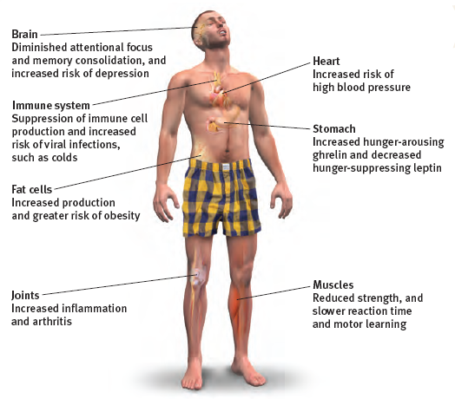
Sleep Loss Effects by Body System
Notes:
No animation.

Slide 19
Sleep Loss/Deprivation=Accident Risk
Accident Frequency
Sleep loss results in more accidents, probably caused by impaired attention and slower reaction time.
Notes:
No animation.
Notice the scales on this slide, with the bottoms chopped off to emphasize the change. In addition, the difference between fall and spring is much greater than the difference being shown. Still, there is an abrupt change apparently attributable to decreased or increased sleep.

Slide 20
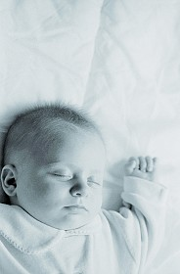
Sleep Hygiene How to Sleep Well
Turn the lights low and turn all screens off.
Eat earlier, and drink less alcohol and caffeine.
Get up at the same time every day.
Exercise (late afternoon is best).
Don’t check the clock; just let it happen.
Get counseling for anxiety and depression.
Notes:
Click to reveal bullets.

Slide 21
Sleep Disorders
Are these people dreaming?
Night terrors refer to sudden scared-looking behavior, with rapid heartbeat and breathing.
Sleepwalking and sleeptalking run in families, so there is a possible genetic basis.
Insomnia: persistent inability to fall asleep or stay asleep
Narcolepsy (“numb seizure”): sleep attacks, even a collapse into REM/paralyzed sleep, at inopportune times
Sleep apnea (“with no breath”): repeated awakening after breathing stops; time in bed is not restorative sleep
These behaviors, mostly affect children, and occur in NONREM-3 sleep. They are not considered dreaming.
Notes:
Click to reveal bullets.
Narcolepsy: note that sleeping pills can cause dependency, with rebound insomnia.
Narcolepsy is NOT simply falling asleep a lot; with true narcolepsy, the attacks happen no matter how well a person sleeps, although stress makes the attacks more likely.
Sleep apnea is NOT just snoring, although snoring is associated with obstructive sleep apnea. Breathing might stop for up to a minute, leading to lower oxygen levels.
Kids experiencing night terrors may have eyes wide open but they are not awake. Night terrors and sleepwalking are NOT taking place in REM sleep; in fact they take place in the deepest NREM-3 sleep. This means sleepwalkers are generally NOT acting out dreams, and kids having nightmares are NOT the kids having night terrors. (If a student says, ‘I remember having night terrors,’ they are not understanding the concept.)

Slide 22
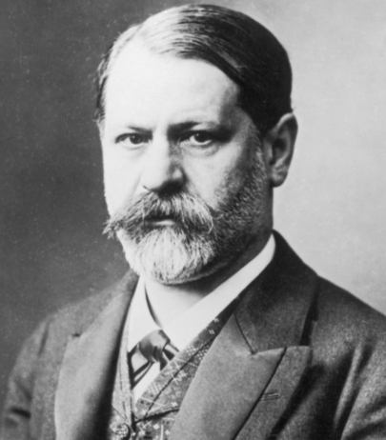
Dreams
the stream of images, actions, and feelings, experienced while in REM sleep
What We Dream About
Dreams often include some negative event or emotion, especially failure dreams (being pursued, attacked, rejected, or having bad luck).
Dreams do NOT often include sexuality.
We may incorporate real-world sounds and other stimuli into dreams.
Dreams also include images from recent, traumatic, or frequent experiences.
What We Dream About: (Psychoanalytic Theory)
Sigmund Freud believed there was often a hidden “latent content” (conflicts, worries, and urges) underneath the symbolic “manifest content” (the plot, actions, and images recalled) of dreams.
Notes:
Click to reveal bullets.
A more elaborate definition of dreams: “an unfolding sequence of thoughts, perceptions, images, and emotions that typically occurs during REM sleep; notable for fantastic imagery, discontinuities, incongruities that the dreamer delusionally accepts, but has later difficulty remembering.”

Slide 23
Theories about Functions of Dreams
Theory | Explanation
Wish fulfillment (psycho- analytic theory)
Information-processing
Physiological function
Activation-synthesis
Cognitive-developmental theory
Lacks any scientific support; dreams may be interpreted in many different ways.
Dreams provide a “psychic safety valve”; they often express otherwise unacceptable feelings, and contain both manifest (remembered) content and a latent content (hidden meaning).
But why do we sometimes dream about things we have not experienced?
Dreams help us sort out the day’s events and consolidate our memories.
This may be true, but it does not explain why we experience meaningful dreams.
Regular brain stimulation from REM sleep may help develop and preserve neural pathways.
The individual’s brain is weaving the stories, which still tells us something about the dreamer.
REM sleep triggers impulses that evoke random visual memories, which our sleeping brain weaves into stories.
Dream content reflects the dreamers’ cognitive development—his or her knowledge and understanding.
Does not address the neuroscience of dreams.
Notes:
Click to show the explanation of each theory and a critical consideration.

