Slide 1
Consciousness
and the Two-Track Mind
PowerPoint® Presentation
by Jim Foley
© 2013 Worth Publishers

Slide 2
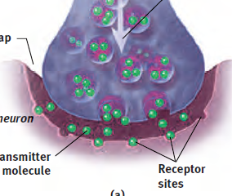
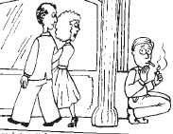
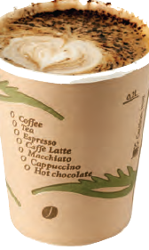
Module 10: Drugs and Consciousness

Slide 3
Topics to digest, to expand our consciousness
When Drugs are a problem: Criteria for Tolerance, Dependence, and Addiction
Types of Psychoactive Drugs:
Depressants
Stimulants
Hallucinogens
Biological, psychological, and social-cultural influences on drug use

Slide 4
Altering Consciousness
Drugs
Psychoactive drugs are chemicals introduced into the body which alter perceptions, mood, and other elements of conscious experience.
Dependence/Addiction
Many psychoactive drugs can be harmful to the body.
Psychoactive drugs are particularly dangerous when a person develops an addiction or becomes dependent on the substance.
Factors related to addiction:
tolerance
withdrawal
impact on daily life of substance use
physical and psychological dependence
Notes:
Click to reveal sidebar and bullets.

Slide 5
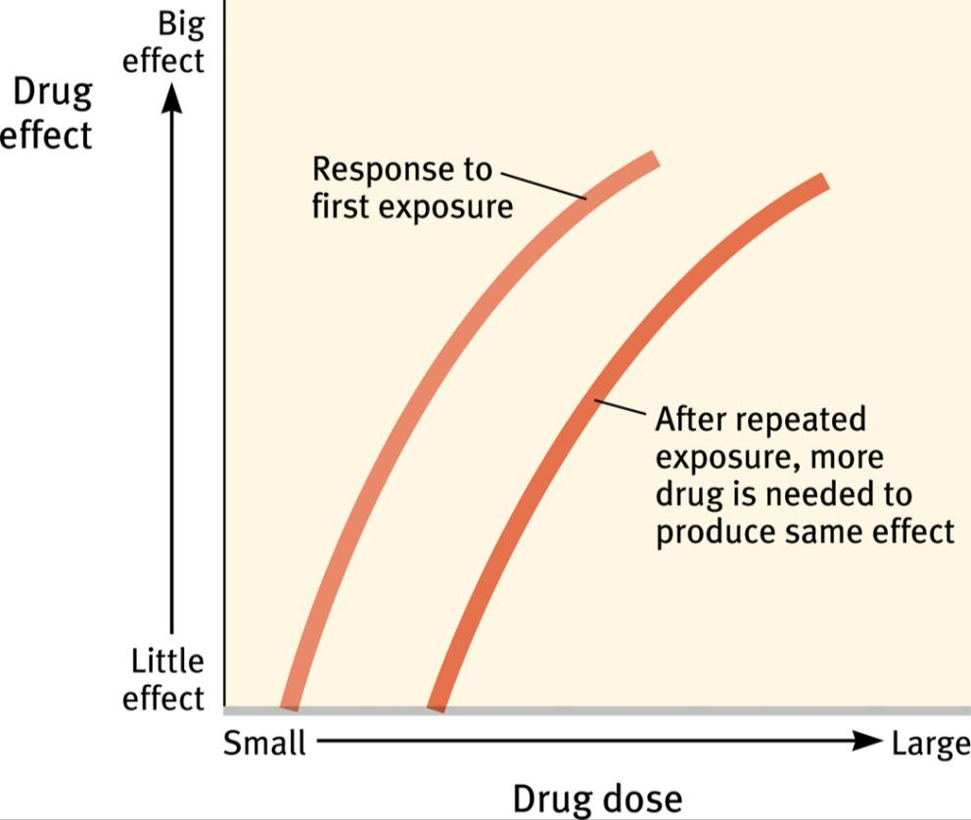
Tolerance
Tolerance of a drug refers to the diminished psychoactive effects after repeated use.
Tolerance feeds addiction because users take increasing amounts of a drug to get the desired effect.
Notes:
No animation.

Slide 6
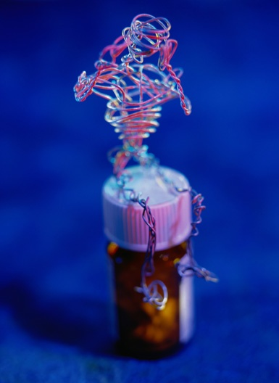
Withdrawal
After the benefits of a substance wear off, especially after tolerance has developed, drug users may experience withdrawal (painful symptoms of the body readjusting to the absence of the drug).
Withdrawal worsens addiction because users want to resume taking the drug to end withdrawal symptoms.
Notes:
Click to reveal bullets.

Slide 7
Dependence
In physical dependence,
the body has been altered in ways that create cravings for the drug (e.g. to end withdrawal symptoms).
In psychological dependence,
a person’s resources for coping with daily life wither as a drug becomes “needed” to relax, socialize, or sleep.
Notes:
Automatic animation.

Slide 8
Dependence on a substance (or activity?)
Tolerance: the need to use more to receive the desired effect
Withdrawal: the distress experienced when the “high” subsides
Using more than intended
Persistent, failed attempts to regulate use
Much time spent preoccupied with the substance, obtaining it, and recovering
Important activities reduced because of use
Continued use despite aversive consequences
Notes:
Click to reveal bullets.
Regarding criteria #4 (“Persistent, failed attempts to regulate use): Why is it a sign of dependence when you want or try to cut back? Aren’t addicts in denial and not bothering to try to quit? This may be true in conversations with family, but internally, here’s one way of looking at what’s going on: it's a sign of dependence when you DO try to quit, and fail. If there is "little effort," you don't find out how hard it is to quit, or there may be little effort to quit because there is little need to quit.

Slide 9
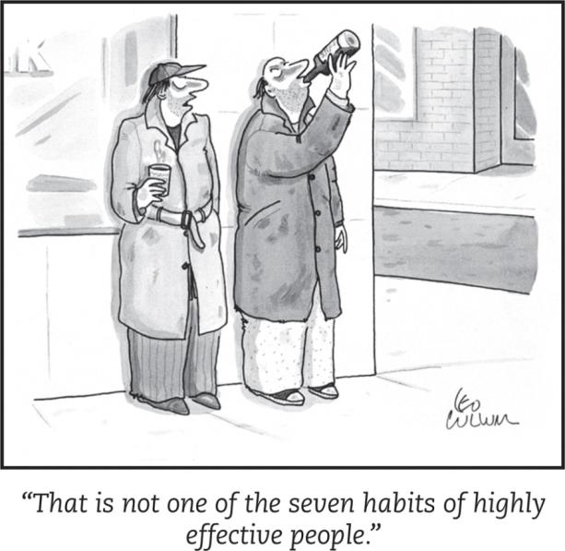
Depressants
Depressants are chemicals that reduce neural activity and other body functions.
Examples:
alcohol
barbiturates
opiates
Notes:
Automatic animation.
Inhalants (glue, kerosene, butane) can be classified as depressants as well.
Obviously, as students may point out here, these substances have other effects besides a depressant effect. Those effects, coming up…

Slide 10
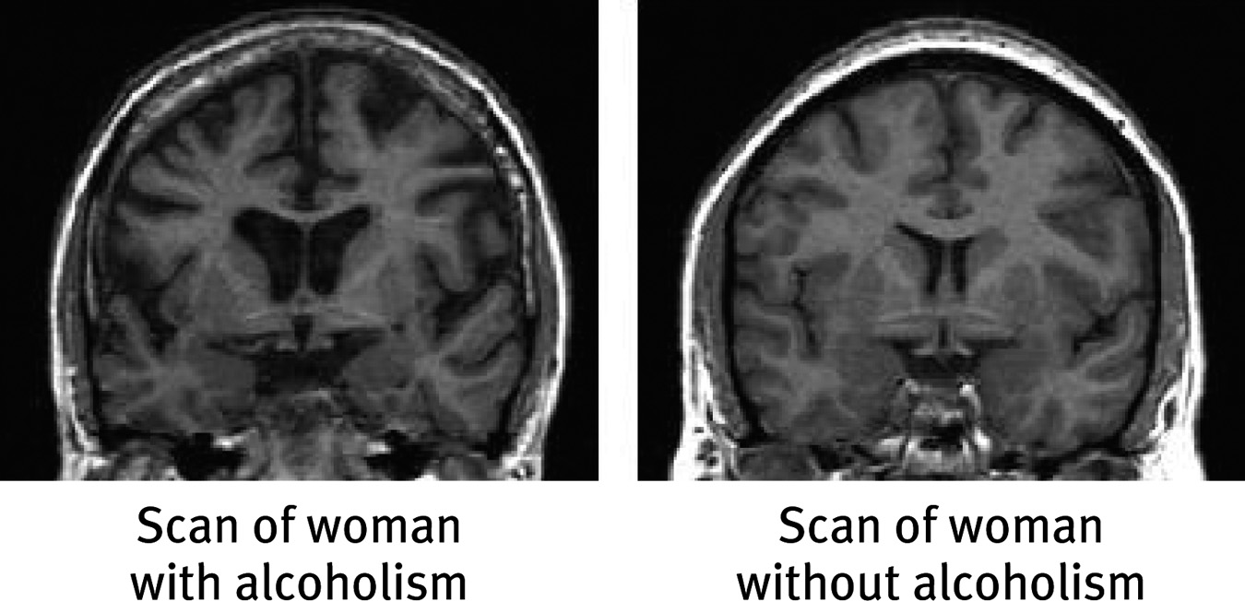
Effects of Alcohol Use
Chronic Use:
Brain damage
Impact on functioning
Slow neural processing, reduced sympathetic nervous system activity, and slower thought and physical reaction
Reduced memory formation caused by disrupted REM sleep and reduced synapse formation
Impaired self-control, impaired judgment, self-monitoring, and inhibition; increased accidents and aggression
Notes:
Click to reveal bullets and example.
Expectancy effects, related to the placebo effect: Some of these effects can happen even when people only THINK they are drinking alcohol.
See if students can see what is different between these two brains (the shrinkage of brain tissue, increased size of fluid spaces).

Slide 11
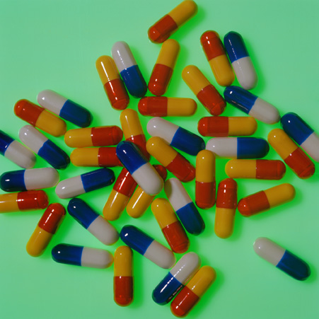
Barbiturates
Barbiturates are tranquilizers--drugs that depress central nervous system activity.
Examples: Nembutal, Seconal, Amytal
Effects: reducing anxiety and inducing sleep
Problems: reducing memory, judgment, and concentration; can lead to death if combined with alcohol
Notes:
Click to reveal bullets.
Note: there are other drugs qualifying as tranquilizers.

Slide 12
Opiates: Highly Addictive Depressants
Opiates depress nervous system activity; this reduces anxiety, and especially reduces pain.
High doses of opiates produce euphoria.
Opiates work at receptor sites for the body’s natural pain reducers (endorphins).
Opiates are chemicals such as morphine and heroin that are made from the opium poppy.
Notes:
Click to reveal bullets.

Slide 13
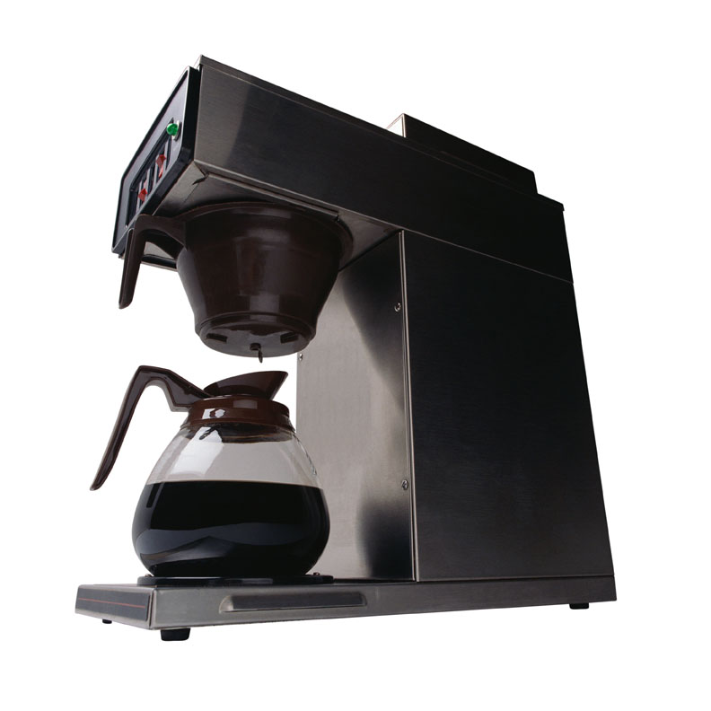
Stimulants
Stimulants are drugs which intensify neural activity and bodily functions.
Some physical effects of stimulants: dilated pupils, increased breathing and heart rate, increased blood sugar, decreased appetite
Examples of stimulants:
Caffeine
Nicotine
Amphetamines, Methamphetamine
Cocaine
Ecstasy
Notes:
Click to reveal text.

Slide 14
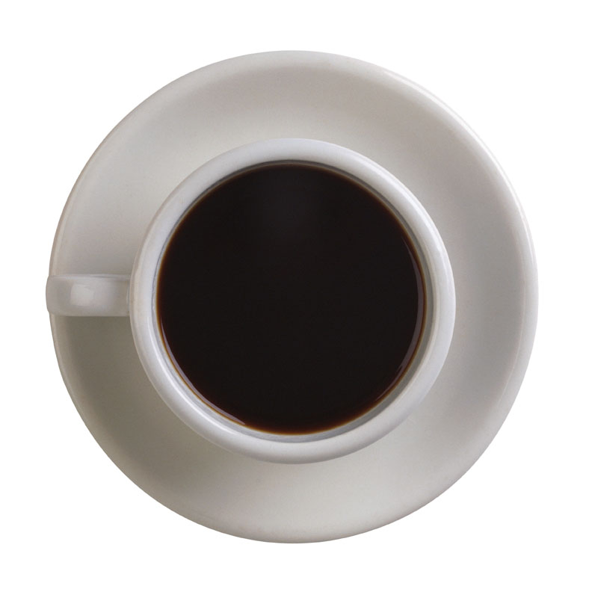
Caffeine
adds energy
disrupts sleep for 3-4 hours
can lead to withdrawal symptoms if used daily:
headaches
irritability
fatigue
difficulty concentrating
depression
Notes:
Click to reveal bullets.

Slide 15
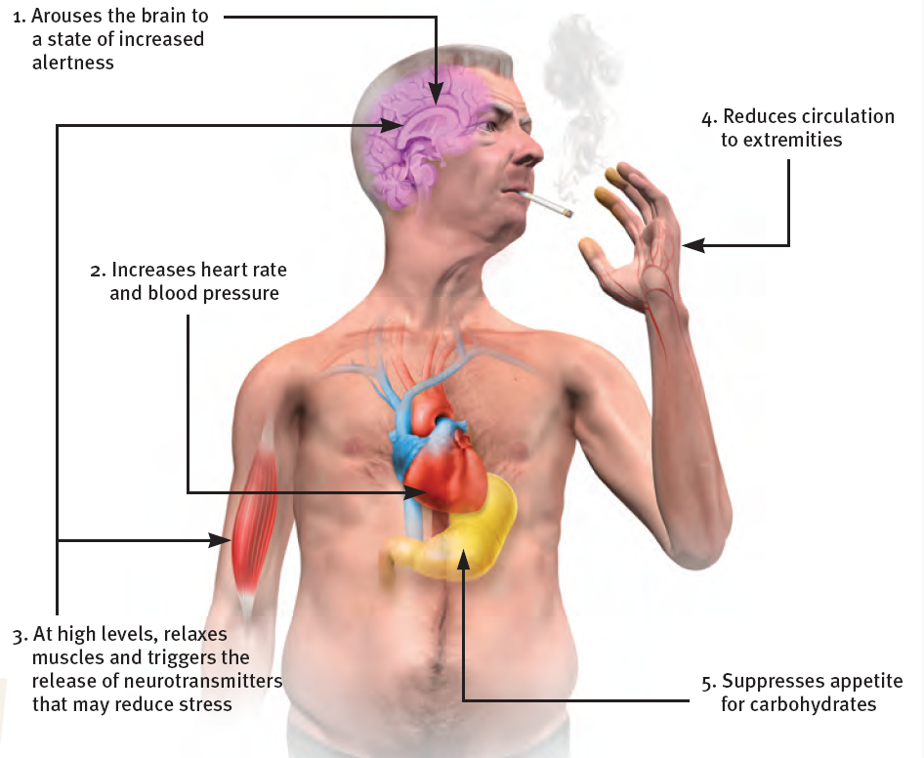
Nicotine
The main effect of nicotine use is ADDICTION.
Notes:
No animation.

Slide 16
Why do people smoke?
Starting to smoke: invited by peers, influenced by culture and media
Continuing: positively reinforced by physically stimulating effects
Not stopping: after regular use, smokers have difficulty stopping because of withdrawal symptoms such as insomnia, anxiety, distractibility, and irritability
Notes:
Click to reveal bullets.
One valid reason people smoke: because they are on fire.

Slide 17
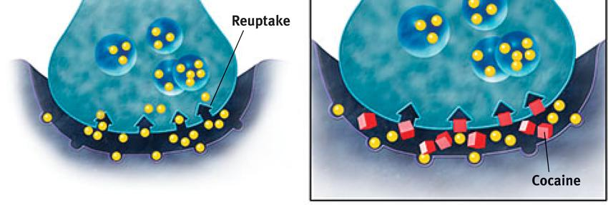
Cocaine
What happens next?
Euphoria crashes into a state worse than before taking the drug, with agitation, depression, and pain.
Users develop tolerance; over time, withdrawal symptoms of cocaine use get worse, and users take more just to feel normal.
Cycles of overdose and withdrawal can sometimes bring convulsions, violence, heart attack, and death.
Cocaine blocks reuptake (and thus increases levels at the synapse of:
dopamine (feels rewarding).
serotonin (lifts mood).
norepinephrine (provides energy).
Effect on consciousness: Euphoria!!! At least for 45 minutes…
Notes:
Click to reveal bullets and sidebar.
Cocaine can be inhaled, smoked (crack), or injected.
Note: there may be expectancy effects adding to the euphoria, just as the effects of alcohol sometimes appear when people think they are using.
The body habituates to cocaine, and then the user is physically and psychologically dependent on increasing amounts.

Slide 18
Methamphetamine
Methamphetamine triggers the sustained release of dopamine, sometimes leading to eight hours of euphoria and energy.
What happens next: irritability, insomnia, seizures, hypertension, violence, depression
“Meth” addiction can become all-consuming.
From 1998 to 2002: Extreme Makeover, Meth Edition
Notes:
Click to reveal bullets.
The brain on meth may lose ability to maintain normal levels of dopamine, perhaps permanently.

Slide 19
Ecstasy/MDMA (MethyleneDioxyMethAmphetamine)
Ecstasy is a synthetic stimulant that increases dopamine and greatly increases serotonin.
Effects on consciousness: euphoria, CNS stimulation, hallucinations, and artificial feeling of social connectedness and intimacy
What Happens Next?
In the short run, regretted behavior, dehydration, overheating, and high blood pressure.
Make it past that, and you might have:
damaged serotonin-producing neurons, causing permanently depressed mood
disrupted sleep and circadian rhythm
impaired memory and slowed thinking
suppressed immune system
Notes:
Click to reveal all bullets.
The increase in serotonin is caused by the increased release AND blocked reuptake. No wonder it can feel so good…for the moment.

Slide 20
Hallucinogens
LSD (lysergic acid diethylamide)
LSD and similar drugs interfere with serotonin transmission.
This causes hallucinations--images and other “sensations” that didn’t come in through the senses.
Marijuana/THC:
What Happens Next?
Impaired motor coordination, perceptual ability, and reaction time
THC accumulates in the body, increasing the effects of next use
Over time, the brain shrinks in areas processing memory and emotion
Smoke inhalation damage
Marijuana/THC (delta-9-TetraHydroCannabinol)
Marijuana binds with brain cannabinoid receptors.
Effect on consciousness:
amplifies sensations
disinhibits impulses
euphoric mood
lack of ability to sense satiety
Notes:
Click to reveal bullets and sidebar.
Hallucinogens are also called psychedelics, which means “mind-manifesting.”
Hallucinations possibly are the source of the images in near-death experiences, explained by the effects of oxygen deprivation to the brain.
LSD hallucinations are most likely to be visual; the hallucinations in schizophrenia are most likely to be auditory.
Marijuana: the affected cannabinoid receptors are located in the frontal lobes, motor cortex, and limbic system
Satiety = feeling full. Not sensing this leads to the oft-reported “munchies”

Slide 21
Summary: Desired Effects of Drugs
Notes:
No animation.

Slide 22
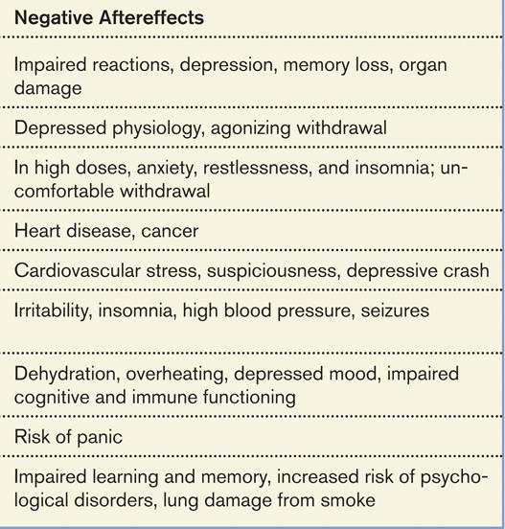
Summary: Aversive Effects of Drugs
Notes:
No animation.

Slide 23
Prevalence of Drug Use in the United States
Nicotine Use as of 2011:
26 percent of high school dropouts smoke; 6 percent of people with graduate degrees smoke
Notes:
No animation.

Slide 24
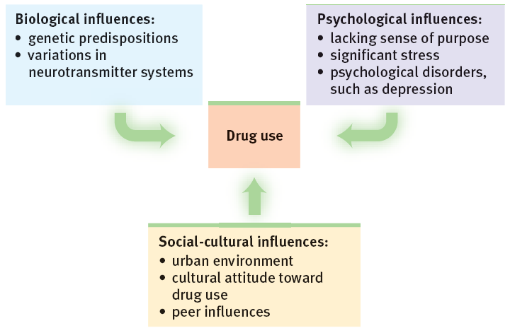
What influences can lead to drug use?
Notes:
No animation.

Slide 25
What can turn drug use into dependence?
Biological factors: dependence in relatives, thrill-seeking in childhood, genes related to alcohol sensitivity and dependence, and easily disrupted dopamine reward system
Psychological factors: seeking gratification, depression, problems forming identity, problems assessing risks and costs
Social influences: media glorification, observing peers
Notes:
Click to reveal bullets.

Slide 26
Are substances inherently addictive and should they be avoided at all cost?
Only 10 to 16 percent of people who try most drugs, even morphine and cocaine, become addicted.
Does recovery require therapy, or require a 12-step group?
In general, recovery rates do not seem to differ much from people quitting on their own.
Controversies Related to Addiction
Is the “addiction” concept applicable to repeated behaviors that do not involve ingesting chemicals?
Labeling it this way can be seen as making excuses for misbehavior such as gambling or sexual affairs. However, many of the dependence criteria are often met, and there may be a dopamine-based chemical process underlying some ‘addictive’ behavior patterns.
Notes:
Click to reveal questions and again to reveal the answer to each question.
Instructor: you could have a discussion related to the third subject/circle. Pick a behavior that has been considered by some as an “addiction,” such as gambling, sex, or internet use, and see if it meets each of the diagnostic criteria for dependence.
Note: The new diagnostic manual, the DSM V, may define behavioral addictions as disorders.

