Slide 1


Developing Through the Lifespan
PowerPoint® Presentation
by Jim Foley
© 2013 Worth Publishers

Slide 2
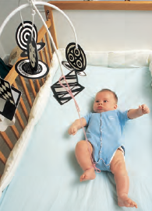
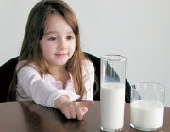
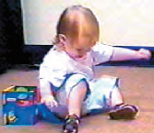
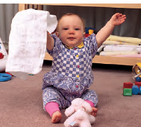
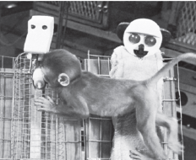
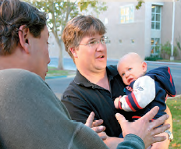
Module 14: Infancy and Childhood
Notes:
Instructor: Each one of these pictures refers to a concept from the module. In lieu of some other way of checking to see if students have done the reading, see if students can guess.
Answer, in order left to right, top row then bottom row:
1) Infant Memory, 2) Conservation (failure), 3) Scaling Error, 4) Stranger anxiety, 5) Object Permanence, 6) Attachement and affection, The Harlows’ Monkeys.

Slide 3
Aspects of starting to grow up
Physical Development/maturation, inc. brain
Cognitive Development: Piaget, Vygotsky
  Sensorimotor, Preoperational, Concrete Operational, Formal Operational Stages
  Egocentrism, Theory of Mind, Autism
  Vygotsky: Mind in Social Context
Social Development
  Attachment: Origins, Styles, Deprivation
  Day Care; Self-Concept; Parenting Styles
Notes:
No animation.

Slide 4
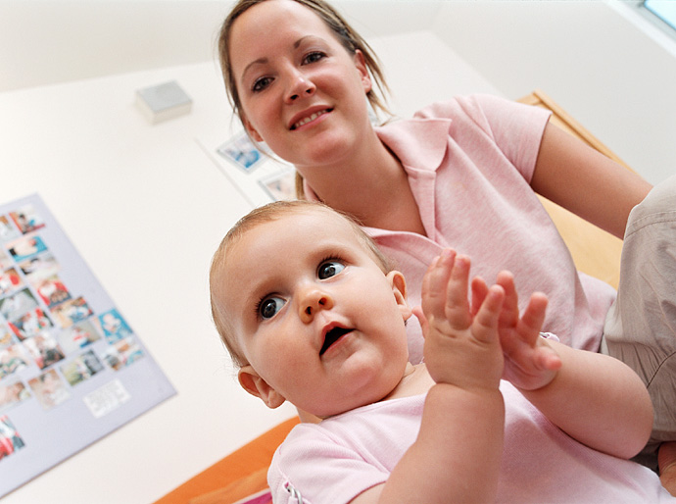

Infancy and Childhood
Infancy: newborns growing almost into toddlers
Childhood: toddlers growing almost into teenagers
For each of these stages, we will study:
brain development.
motor development.
cognitive development.
social and emotional development.
Notes:
Click to reveal definitions and bar at bottom.
The book defines the childhood age span as “growing from toddler to teenager.” This is not meant to imply that childhood includes the teenage years.

Slide 5
Maturation:
not the meaning you might think
In psychology, “maturation” refers to changes that occur primarily because of the passage of time.
In developmental psychology, maturation refers to biologically-driven growth and development enabling orderly (predictably sequential) changes in behavior.
Experience (nurture) can adjust the timing, but maturation (nature) sets the sequence.
For example, infant bodies, in sequence, will lift heads, then sit up, then crawl, and then walk.
Maturation, the biological unfolding, will be seen in:
brain development.
motor development.
Maturation in infancy and early childhood affects the brain and motor skills.
Notes:
Click to reveal bullets and example.
Instructor: Mention before the text appears on screen:
“This is one of the words in this course that means something different in psychology than in popular usage (other examples include arousal, learning, conservation, theory, etc.). When we use the term, we do NOT mean “becoming socially aware and competent as an adult, but… [now click to reveal text]”
You might ask, “for these two topics, speculate: which of the changes, or the timing and sequence of those changes, is driven by biology/unfolding, and which are triggered or greatly effected by environment/experience?”

Slide 6
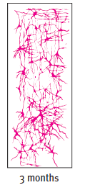
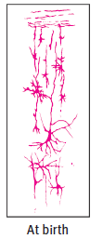
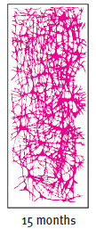
Brain Development:
Building and Connecting Neurons
In the womb, the number of neurons grows by about 750,000 new cells per minute in the middle trimester.
Beginning at birth, the connections among neurons proliferate. As we learn, we form more branches and more neural networks.
In infancy, the growth in neural connections takes place initially in the less complex parts of the brain (the brainstem and limbic system), as well as the motor and sensory strips.
  → This enables body functions and basic survival skills.
In early childhood, neural connections proliferate in the association areas.
  → This enables advancements in controlling attention and behavior (frontal lobes) and also in thinking, memory, and language.
Notes:
Click to reveal bullets and images.

Slide 7
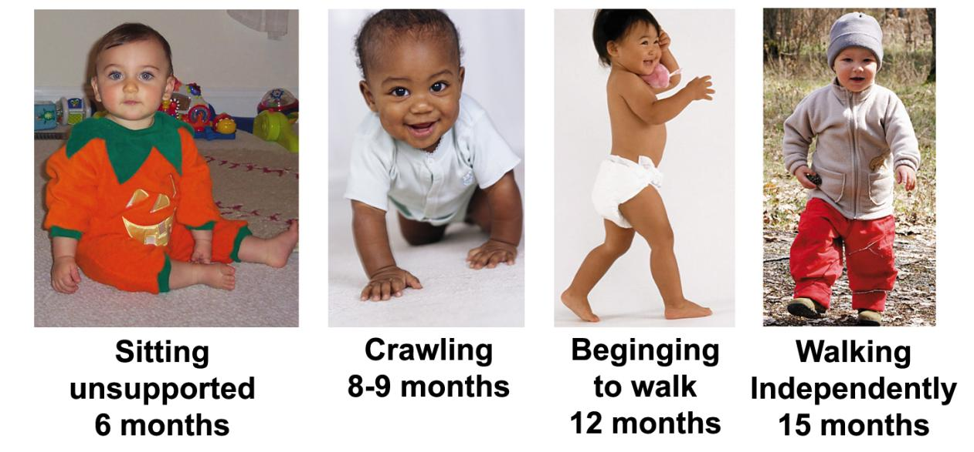
Motor Development
Maturation takes place in the body and cerebellum enabling the sequence below.
Physical training generally cannot change the timing.
Notes:
No animation.
Studies on an identical twins have shown that rushing kids to learn to walk, learn to climb stairs, etc. does not seem to do much to make it happen sooner than it would happen anyway.

Slide 8
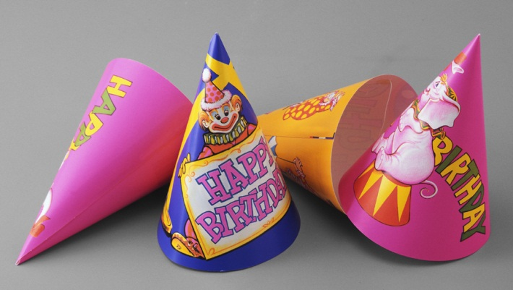
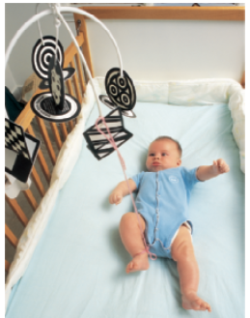
Baby Memory
Infantile Amnesia
In infancy, the brain forms memories so differently from the episodic memory of adulthood that most people cannot really recall memories from the first three years of life.
A birthday party when turning three might be a person’s first memory.
Learning Skills
Infants can learn skills (procedural memories).
This three month old can learn, and recall a month later, that specific foot movements move specific mobiles.
Notes:
Click to reveal bullets.
Instructor--some details on infantile amnesia: the fourth birthday party is more likely (than the third) to be a real memory, and more accurate. Those memories from early years (like most memories, but even more so at this age) are likely to be reconstructions, built mostly from stories told to them by others when they were older. Yet these memories feel like recalled events; more about this in the chapter on memory.
Learning skills: this skill or “procedural memory” could be seen as an example of operant conditioning. Babies also acquire fear, which of course is classical conditioning. These terms are omitted from the slide because these concepts typically would not have been introduced yet in the course, but you may want to mention it here.

Slide 9
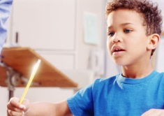
Cognitive Development
Cognition refers to the mental activities that help us function, including:
problem-solving.
figuring out how the world works.
developing models and concepts.
storing and retrieving knowledge.
understanding and using language.
using self-talk and inner thoughts.
Notes:
No animation.

Slide 10
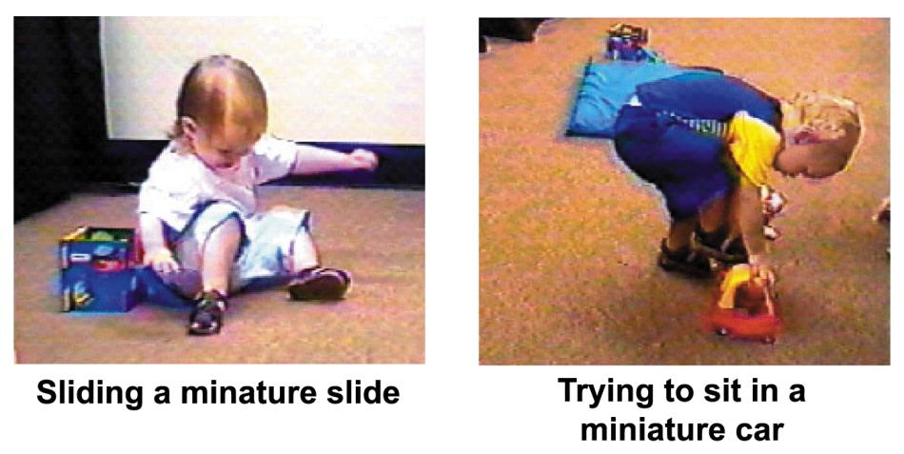
Cognitive Development:
Jean Piaget (1896-1980)
We don’t start out being able to think like adults.
Jean Piaget studied the errors in cognition made by children in order to understand in what ways they think differently than adults.
The error below is an inability to understand scale
(relative size).
Notes:
Click to reveal bullets and example.
Jean Piaget was originally a biologist but he began observing children, at first mainly his own kids and relatives. He generated novel ideas about development throughout the mid-20th century.

Slide 11
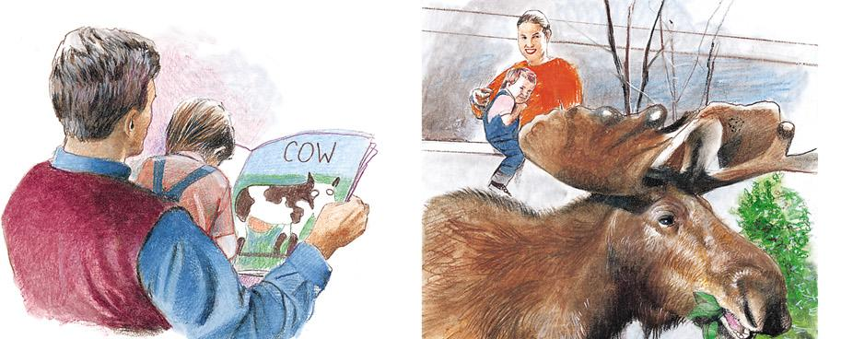
Jean Piaget and Cognitive Development:
Schemas
An infant’s mind works hard to make sense of our experiences in the world.
An early tool to organize those experiences is a schema, a mental container we build to hold our experiences.
Schemas can take the form of images, models, and/or concepts.
This child has formed a schema called “COW” which he uses to think about animals of a certain shape and size.
“Cow!”
“Cow!”
Notes:
Click to reveal bullets and example.

Slide 12
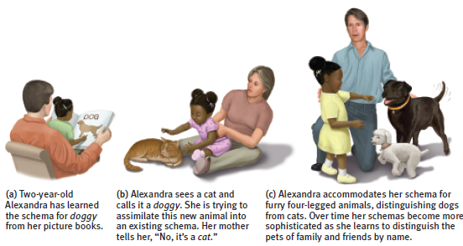
Jean Piaget and Cognitive Development:
Assimilation and Accommodation
How can this girl use her “dog” schema when encountering a cat?
She can assimilate the experience into her schema by referring to the cat as a “dog”
or
she can accommodate her animal schema by separating the cat, and even different types of dogs, into separate schemas.
Notes:
Click to reveal answer/example.
If students want this stated in definition form:
assimilation refers to incorporating new experiences into our existing schema/categories;
accommodation refers to adjusting our schema to better fit our experiences.
Whether the mini-poodle in the picture is categorized as a dog may be subject to debate… ☺

Slide 13
The Course of Development:
Stages
Jean Piaget believed that cognitive development:
is a combination of nature and nurture. Children grow by maturation as well as by learning through interacting/playing with the environment.
is not one continuous progression of change. Children make leaps in cognitive abilities from one stage of development to the next.
Issue | Jean Piaget’s Vote
Nature vs. Nurture | Both
Continuity vs. Stages | Stages
Notes:
Click to reveal bullets.
Instructor: here you can highlight the “nature vs. nurture” and “continuity vs. stages” concepts, and question where Jean Piaget stands on these issues.
You can mention here or later that Piaget’s positions have been somewhat modified by recent research, especially the idea that certain stages are tied maturationally/genetically to certain ages.

Slide 14
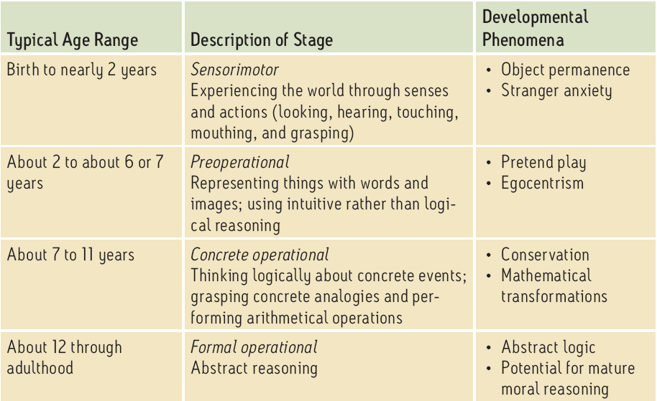
Jean Piaget’s Stages of
Cognitive Development
Notes:
No animation.

Slide 15
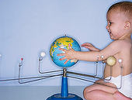
Sensorimotor Stage (From Birth to Age 2)
In the sensorimotor stage, children explore by looking, hearing, touching, mouthing, and grasping.
Cool cognitive trick learned at 6 to 8 months, coming up next: object permanence.
Notes:
No animation.

Slide 16
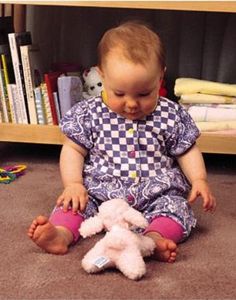
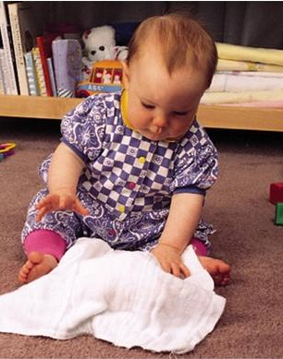
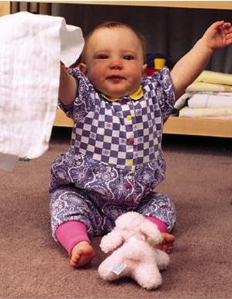
Object Permanence
There’s a game I’ve learned to play all by myself: peekaboo!
Hmm, a bear, should I put it in my mouth?
Through games like “peekaboo,” kids learn object permanence--the idea that objects exist even when they can’t be seen.
Notes:
Click to start animation.
Peekaboo brings out issues of “nature vs. nurture,” as well as “stages of maturation vs. practice at playing.” Since kids develop this ability automatically but also practice to develop it, how much of the development of object permanence is nature/maturation, and how much is nurture/experience?

Slide 17

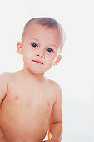
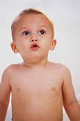
Can Children Think Abstractly?
Jean Piaget felt that kids in the sensorimotor stage did not think abstractly.
Yet there is some evidence that kids in this stage can notice violations in physics (such as gravity).
Does that mean babies are doing physics?
Notes:
Click to reveal bullets/animation; see this in slide show mode to see the ball obeying gravity, and not obeying gravity.
“Violations in physics and math” examples: kids look more surprised when they see a ball start to drop and then stop. You might want to simulate this with a ball on a stick.

Slide 18
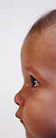
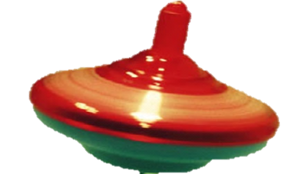
Is This Math?
If so, kids in the “sensorimotor” stage do math.
Babies stare longer and with surprise when numbers don’t make sense.
  Is this math? Was Jean Piaget wrong?
Notes:
Click to start animation.
This slide depicts the results of an experiment. In the animation, two toys minus one two should leave one two, but three are there. This would trigger a surprised stare in many babies.
Jean Piaget believed that kids in the sensorimotor stage cannot handle even basic math, seeing this as a concrete operational skill. How can we explain this result? Are the kids doing subtraction, or is it something else?
Narration: One toy comes in, then a second, then the toys are hidden. When the screen is taken away, the baby is less surprised if there is now one toy. However, if there is a different amount, they look more surprised and stare longer.

Slide 19
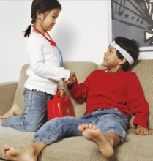
What can kids do in the preoperational stage?
Represent their schema, and even some feelings, with words and images.
Use visual models to represent other places, and perform pretend play.
Picture other points of view, replacing egocentrism with theory of mind.
Use intuition, but not logic and abstraction yet.
Notes:
Click to reveal bullets.

Slide 20
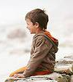
Egocentrism:
“I am the World.”
What mistake is the boy making?
Do you have a brother?
Yes. Jim.
Does Jim have a brother?
No.
How does this relate to our definition of egocentrism?
Notes:
Click to reveal all text.
Answer to the slide question: this boy is unable to see his brother Jim’s perspective and unable to see himself as a brother rather than just as ME, the center of the world.
Egocentrism is another one of those terms that has a different meaning in psychology than in its more vague popular use. It is not about selfishness, but about being unable to see another person’s perspective, or even to imagine that other people have a perspective that might be different from your own.
Hiding their eyes: If I can’t see, you can’t see, right? If the world has just become dark, how can anyone else see?
Egocentrism is also a hallmark of autism, to such an extent that if you point somewhere, an autistic child might look at the end of your finger or at a point past the finger from their perspective, rather than being able to tell where you are looking.

Slide 21
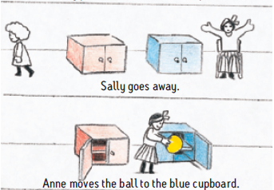
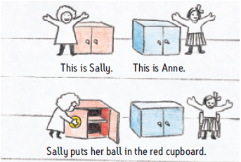
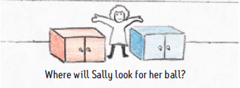
Maturing beyond Egocentrism:
Developing a “Theory of Mind”
Theory of mind refers to the ability to understand that others have their own thoughts and perspective.
With a theory of mind, you can picture that Sally will have the wrong idea about where the ball is.
Notes:
Click through to show the three scenes.
This test is typically called the “false belief test” because the younger child is asked to be able to tell when another person has the wrong idea, or a false belief, about where something is. It is a screening test for autism.
The ability to understand a false belief appears at age 3.5 to 4.5, or much later in children with autism spectrum disorders (including Asperger’s Disorder), although I have had a first-year college male fail this test despite repeated explanation and in-class demonstration.

Slide 22
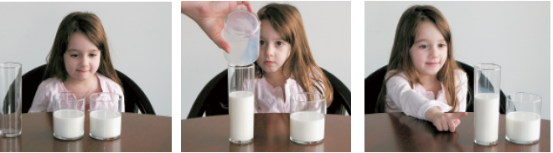
Examples of Operations that Preoperational Children Cannot Do…Yet
Conservation refers to the ability to understand that a quantity is conserved (does not change) even when it is arranged in a different shape.
Which row has more mice?
Notes:
Click to reveal all text.
This child could “conserve” the amount of fluid by mentally reversing the operation of pouring it into a different container, but this is difficult for a child at the start of the preoperational phase.
Click for another example: if objects are arranged on a table in two rows of five, but one row is more spread out, a preoperational child will feel sure that there are more objects in the spread-out row.

Slide 23
Autism Spectrum Disorders
Children with disorders on the autism spectrum have difficulties in three general areas:
  establishing mutual social interaction
  using language and play symbolically
  displaying flexibility with routines, interests, and behavior
Children with disorders on the autism spectrum have more difficulty than a typical child in mentally mirroring the thoughts and actions of others; this difficulty has been called “mind blindness.”
Notes:
Click to reveal bullets.
The brain in autism is marked by “islands of ability” (usually very concrete abilities) but the parts of the brain are not well connected to each other; the first talent to be missing is often social intuition.
The official diagnosis of Asperger’s Disorder will disappear soon after this textbook is published. Asperger’s Disorder will be considered to be synonymous with the higher-functioning end of the autism spectrum. That diagnostic change may also affect the “1 in 110” figure; this is based on the current overall category of Pervasive Developmental Disorder, PDD, about half of which is “PDD-NOS”, Pervasive Developmental Disorder Not Otherwise Specified, which includes many children who do not meet the full criteria for autism or any other PDD.

Slide 24
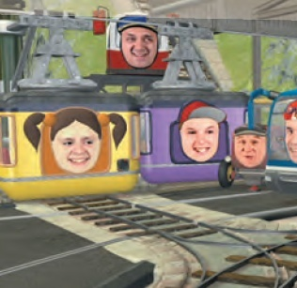
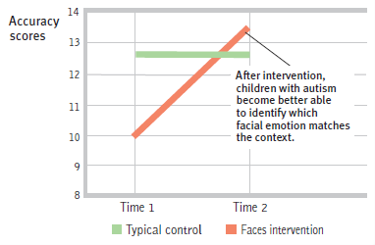
How do we teach social/emotional understanding to children with autism?
Happy train
Are the autistic kids learning to understand the emotions of others, or are they memorizing that certain facial positions correspond to certain emotion words?
Notes:
Click to reveal question.
The book recommends the transporter’s website, but the only way to see a video for free is to find some copy of an episode on YouTube, such as http://www.youtube.com/watch?v=U4yJ3cxT3qs
Another path for teaching about emotions in real social context is the “Social Stories and Comic Book Conversations” techniques associated with Carol Gray.

Slide 25

The Concrete Operational Stage
begins at ages 6-7 (first grade) to age 11
children now grasp conservation and other concrete transformations
they also understand simple mathematical transformations the reversibility of operations (reversing
3 + 7 = 10 to figure out that 10 - 7 = 3).
Notes:
Click to reveal bullets.
Just as toddlers enjoy practicing their newfound understanding of object permanence by playing peekaboo, kids in the concrete operational stage might like playing around with their understanding of conservation with jokes like the one in the book: “don’t cut the pizza into eight pieces, I can only eat six.” Back to the glass of milk example, a kid at this age might laugh at hearing or saying, “could you pour that milk into a taller glass, I’m really thirsty.”

Slide 26
Formal Operational Stage (Age 11 +)
Concrete operations include analogies such as “My brain is like a computer.”
Includes arithmetic transformations:
if 4 + 8 = 12, 12 – 4 = ?
Formal operations includes allegorical thinking such as “People who live in glass houses shouldn’t throw stones” (understanding that this is a comment on hypocrisy).
Includes algebra:
if x = 3y and x – 2y = 4, what is x?
Notes:
Click to reveal text boxes and examples.
The arithmetic transformation only requires reversing the operation, and by this stage, a child should be able to answer “8.”
The algebra problem requires understanding and manipulating symbols, in this case:
If 3y = x, we can substitute “3y” for “x” in the second equation: 3y-2y = 4, or simply y = 4. If x = 3y, then x = 3(4), or 12.
With formal operations thought comes the skill of imagining the realities that might exist rather than the concrete here and now.

Slide 27
Does Logical Reasoning Begin Earlier?
Kids that Jean Piaget considered too young for logic can correctly answer:
  If John is in school, then Mary is in school.
  John is in school. What can you say about Mary?
Is this formal reasoning (in logic terms: “given A → B; if A, then also B”), or is it simply following a word pattern?
To find out, it might be interesting to test at what age a child would be able to answer these tougher logic questions?
  If John is in school, then Mary is in school.
  John is NOT in school. What can you say about Mary?
  Mary is in school. What can you say about John?
  Mary is NOT in school. What can you say about John?
Notes:
Click to reveal bullets.
Instructor: After reminding your students that they are in the formal operational stage, have them try to answer the questions. Hopefully the first one, from the text, is obvious (Mary is in school).
After building the student’s confidence, click to try the others. Answers:
1. Nothing/Unknown. We were not told that Mary is in school ONLY if John is there.
2. Nothing/Unknown. Same reason.
3. John cannot be in school. If he were there, Mary would be also. (back to logic terms: given A →B, then ‘Not B’ implies ‘Not A’).

Slide 28
Reassessment of Jean Piaget’s Theory
Although Jean Piaget’s observation and stage theory are useful, today’s researchers believe:
development is a continuous process.
children show some mental abilities and operations at an earlier age than Piaget thought.
formal logic is a smaller part of cognition, even for adults, than Piaget believed.
Using Models:
Symbolic Thinking?
Three-year-olds can use a tiny model of a room as a map, helping them to picture the location of objects in a full-sized room.
Does this 3-year-old ability mean that Piaget was wrong? Do kids use symbolic thought much earlier than he suggested?
Notes:
Click to reveal all text.
If this is symbolic thought, then adult primates such as bonobos have this too.
There is a great video starring Alan Alda showing a bonobo (a peaceful relative of the chimpanzee) able to do what a two and a half year old cannot do; find the hidden object based on a model.
Is this symbolic thought, or is a visual mental model not the same as an abstract symbol?
Click to reveal sidebar.

Slide 29
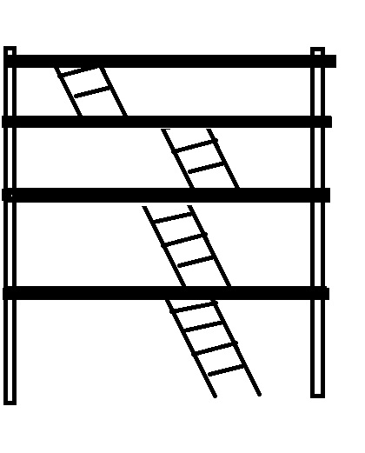

Lev Vygotsky: Alternative to Jean Piaget
Lev Vygotsky (1896-1934) studied kids too, but focused on how they learn in the context of social communication.
Principle: children learn thinking skills by internalizing language from others and developing inner speech: “Put the big blocks on the bottom, not the top…”
Vygotsky saw development as building on a scaffold of mentoring, language, and cognitive support from parents and others.
Notes:
Click to reveal bullets and example.
Regarding the first bullet point: by contrast, Jean Piaget was more focused on how children learned through interaction with the physical environment.

Slide 30
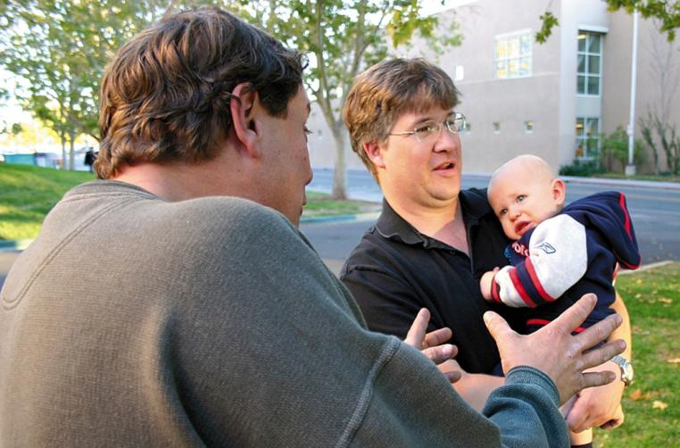
Social Development
Stranger Anxiety
Stranger anxiety develops around ages 9 to 13 months. In this stage, a child notices and fears new people.
Explaining Stranger Anxiety
How does this develop?
As children develop schemas for the primary people in their lives, they are more able to notice when strangers do not fit those schemas. However, they do not yet have the ability to assimilate those faces.
Why does this develop?
An evolutionary psychologist would note that a child is learning to walk at this age. Some of the children who walked toward unfamiliar creatures might have died before having a chance to pass on genes.
Notes:
Click to reveal bullets.

Slide 31
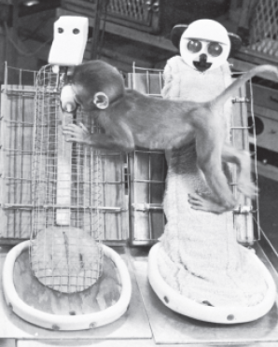
Social Development:
Attachment
Attachment refers to an emotional tie to another person.
In children, attachment can appear as a desire for physical closeness to a caregiver.
Origins of Attachment
Experiments with monkeys suggest that attachment is based on physical affection and comfortable body contact, and not based on being rewarded with food.
Notes:
Click to reveal all text.
Instructor: The word “tie” here implies something even stronger, tighter, and closer than the word “connection.” Sometimes this attachment includes anxiety/distress when separated from the caregiver, as we will see in upcoming slides.
In experiments by Harry Harlow (in the late 1950s and 1960s) that gave monkeys a choice of surrogate mothers, a baby monkey would cling to a comfortable cloth ‘mother’ rather than the ‘mother’ that provided food. However, there are numerous critiques of these experiments.

Slide 32

Origins of Attachment:
Familiarity
Most creatures tend to attach to caregivers who have become familiar.
Birds have a critical period, hours after hatching, during which they might imprint. This means they become rigidly attached to the first moving object they see.
Notes:
No animation.
Humans are more flexible than birds because humans do not have a critical period or rigid/imprinted attachments. However, humans still become emotionally attached to people and objects based on the mere exposure effect--feeling comfortable with what is familiar.
This may be one small part of explaining hoarding, or why it is hard to lose a relationship because of breakup or death even when the relationship was dysfunctional.

Slide 33
Attachment Variation:
Styles of Dealing with Separation
The degree and style of parent-child attachment has been tested by Mary Ainsworth in the “strange situations” test. In this test, a child is observed as:
a mother and infant child are alone in an unfamiliar (“strange”) room; the child explores the room as the mother just sits.
a stranger enters the room, talks to the mother, and approaches the child; the mother leaves the room.
After a few moments, the mother returns.
Reactions to Separation and Reunion
Secure attachment: most children (60 percent) feel distress when mother leaves, and seek contact with her when she returns
Insecure attachment (anxious style): clinging to mother, less likely to explore environment, and may get loudly upset with mother’s departure and remain upset when she returns
Insecure attachment (avoidant style): seeming indifferent to mother’s departure and return
Notes:
Click to reveal bullets and sidebar.
The book mixes the descriptions of the two insecure attachment styles together; I have separated them here.
Some theorists have added a fourth type of attachment--disorganized, not forming a coherent or consistent style.

Slide 34
What causes these different attachment styles:
nature or nurture?
Is the “strange situations” behavior mainly a function of the child’s inborn temperament?
Is the behavior a reaction to the way the parents have interacted with the child previously? If so, is that caused by the parenting behavior?
Temperament refers to a person’s characteristic style and intensity of emotional reactivity.
Some infants have an “easy” temperament; they are happy, relaxed, and calm, with predictable rhythms of needing to eat and sleep.
Some infants seem to be “difficult”; they are irritable, with unpredictable needs and behavior, and intense reactions.
Mary Ainsworth believed that sensitive, responsive, calm parenting is correlated with the secure attachment style.
Monkeys with unresponsive artificial mothers showed anxious insecure attachment.
Training in sensitive responding for parents of temperamentally-difficult children led to doubled rates of secure attachment.
Notes:
Click to show bullets under each question.
Note: we are later going to take a broader look at different parenting styles and the correlation with child behaviors. Here, the focus is on parent and child behaviors related to attachment.
Child temperament and attachment: there is usually a third style listed when describing temperament, called “slow to warm up.”
As we shall see when discussing personality, these temperamental traits may be genetically based and persist into adulthood in some form.
Parental influences on attachment: the correlational observations are not enough, since the correlation could have been driven either by the child’s temperament or by the parent’s behavior.
The experiment, by Dymphna C. van den Boom, involved random assignment to experimental and control groups. The control group showed 28 percent of infants being securely attached at 12 months. The experimental group showed 68 percent, actually above the average for infants in general, despite beginning with temperamentally difficult infants.

Slide 35
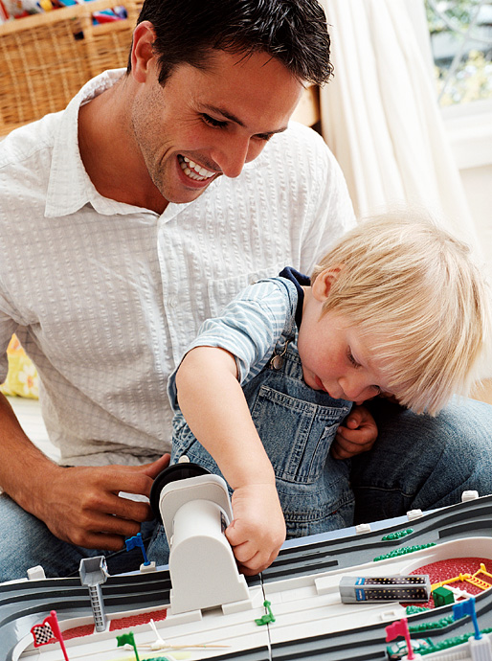
Fathers Count Too
Many studies of the impact of parenting have focused on mothers.
Correlational studies show a strong relationship between paternal (father) involvement in parenting and the child’s academic success, health, and overall well-being.
Notes:
Click to reveal bullets.

Slide 36
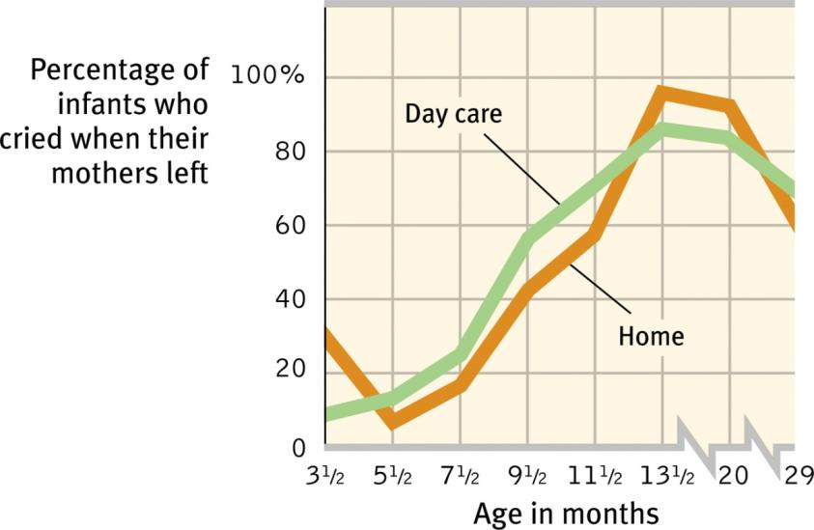
Influences on Separation Anxiety
Effects of Environment on Attachment
Separation anxiety peaks and fades whether kids are at home or in day care.
Notes:
No animation.
Instructor: More about day care coming up; this slide is in this location following the sequence of material in the text, but you could move it a few slides forward to join the slide on day care.

Slide 37
Attachment Styles… not just about bonding with parents
Are basic trust and attachment styles determined in childhood?
Erik Erikson believed that basic trust is established by relationships with early caregivers.
Are trust and attachment styles:
  set by genetics?
  formed by early experiences with parents?
  reshaped by new relationship experiences?
Erik Erikson’s concept of basic trust resembles the concept of attachment, but extends beyond the family into our feeling of whether the world is predictable and trustworthy.
Attachment style may be relevant to our ability to manage and enjoy adult relationships. It may even be relevant to our motivations to achieve or to avoid risks.
Notes:
Click to reveal bullets and sidebar.

Slide 38

Deprivation of Attachment
If children live without safe, nurturing, affectionate caretaking, they may still be resilient, that is bounce back, attach, and succeed.
However, if the child experiences severe, prolonged deprivation or abuse, he or she may:
  have difficulty forming attachments.
  have increased anxiety and depression.
  have lowered intelligence.
  show increased aggression.
Notes:
Click to reveal bullets.
Genetics and biology still play a role in determining the outcome of prolonged deprivation. Some people’s stress hormone systems seem to be more easily damaged by chronic stress, and some people’s serotonin pathways more easily become inefficient.

Slide 39
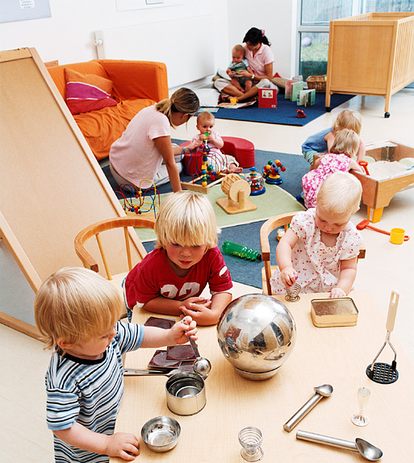
Children in Day Care
We have seen already that time in day care does not significantly increase or decrease separation anxiety.
Warm interaction with multiple caretakers can result in multiple healthy attachments.
Time in day care correlates with advanced thinking skills… and also with increased aggression and defiance.
Notes:
Click to reveal bullets.
Instructor: For this last bullet point, see if students notice, thanks to the word “correlation,” that there is more than one possible explanation for this result:
placement in day care may facilitate advanced thinking and encourage defiance and aggression,
OR
2) more educated parents, and more irritable and angry parents, are two populations more likely to place the child in day care.

Slide 40

Childhood:
Self-Concept
A major task of infancy may be to form healthy attachments.
A major task of childhood may be to form a healthy self-concept: a stable and positive understanding of identity.
By age 8-10, a child moves from “that’s me in the mirror” to “I have skills, preferences, and goals”; this prepares the child for confident success.
Notes:
Click to reveal bullets.
Of course, a child isn’t going to say these words in quotes on this slide, but it may come out in different words:
Skills: “I’m good at…”
Preferences: “I like boys… sports… books”
Goals: “I want to be a ____ when I grow up…”

Slide 41
Childhood:
Hypothetical Parenting Styles
Style | Response to Child’s Behavior
Authoritarian “Too Hard” | Parents impose rules “because I said so” and expect obedience.
Permissive “Too Soft” | Parents submit to kids’ desires, not enforcing limits or standards for child behavior.
Authoritative “Just Right” | Parents enforce rules, limits, and standards but also explain, discuss, listen, and express respect for child’s ideas and wishes.
Notes:
No animation.
Instructor: You might note here that we have earlier discussed the influences of parenting behaviors on infant attachment. Now we’re looking at a slightly different picture--the way parents handle the issue of control in childhood.
Response to child’s behavior: how does this style control, manage, or otherwise respond to child behavior?

Slide 42

Outcomes with Parenting Styles
Authoritative parenting, more than the other two styles, seems to be associated with:
  high self-reliance.
  high social competence.
  high self-esteem.
  low aggression.
But are these a result of parenting style, or are parents responding to a child’s temperament? Or are both a function of culture ? Or genes?
Notes:
Click to reveal bullets.
There could also be other factors, such as genes or culture, affecting both the child outcomes and the parenting styles.

