Slide 1
Learning
PowerPoint® Presentation
by Jim Foley
© 2013 Worth Publishers

Slide 2
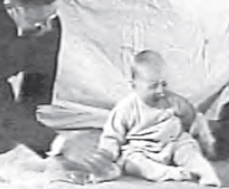
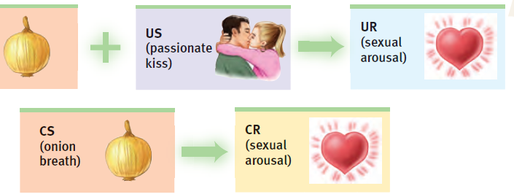
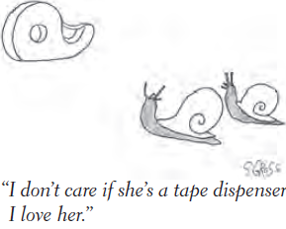
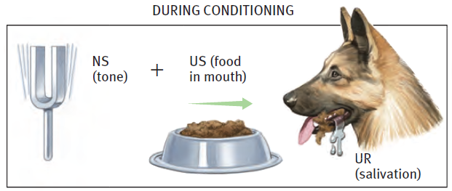
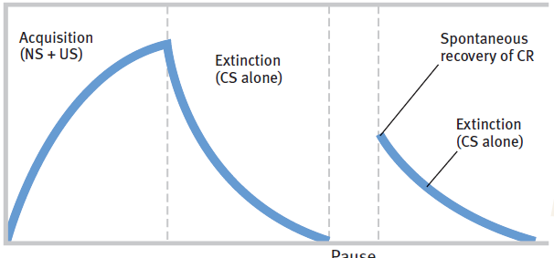
Module 20: Basic Learning Concepts and Classical Conditioning

Slide 3
Topics to help you build new associations about conditioning
The various types and processes of learning
Classical conditioning vs Operant Conditioning
Pavlov’s experiments and concepts
Acquisition, Extinction, Spontaneous Recovery
Generalization and Discrimination
Applications of Classical Conditioning
Notes:
No animation.

Slide 4
How does learning happen other than through language/words?
We learn from experience:
We learn by association:
when we learn to predict events we already like or don’t like by noticing other events or sensations that happen first.
when our actions have consequences.
when we watch what other people do.
when two stimuli (events or sensations) tend to occur together or in sequence.
when actions become associated with pleasant or aversive results.
when two pieces of information are linked.
Notes:
Click to reveal bullets under each heading.
Instructor: see if students can identify which forms of conditioning are being referred to in points 1-3 of either column, before going on to the next slide for the answers.

Slide 5
Types of Learning
Classical conditioning: learning to link two stimuli in a way that helps us anticipate an event to which we have a reaction
Operant conditioning: changing behavior choices in response to consequences
Cognitive learning: acquiring new behaviors and information through observation and information, rather than by direct experience
Notes:
Automatic animation.
There are millions of sensory neurons and millions of motor neurons, but BILLIONS of interneurons.

Slide 6
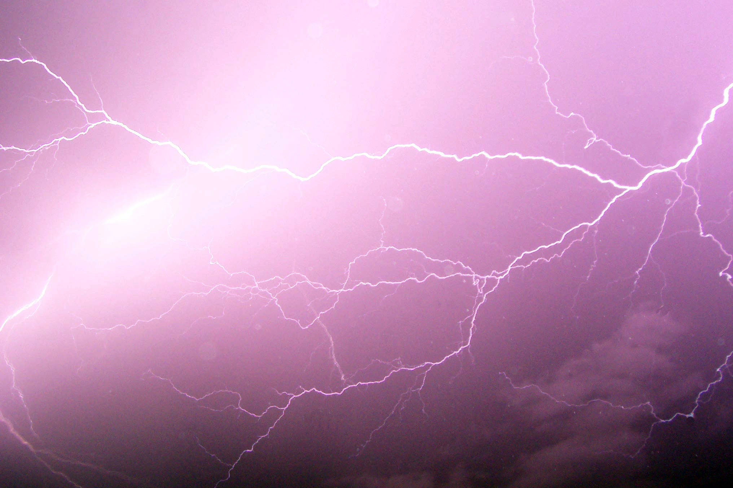
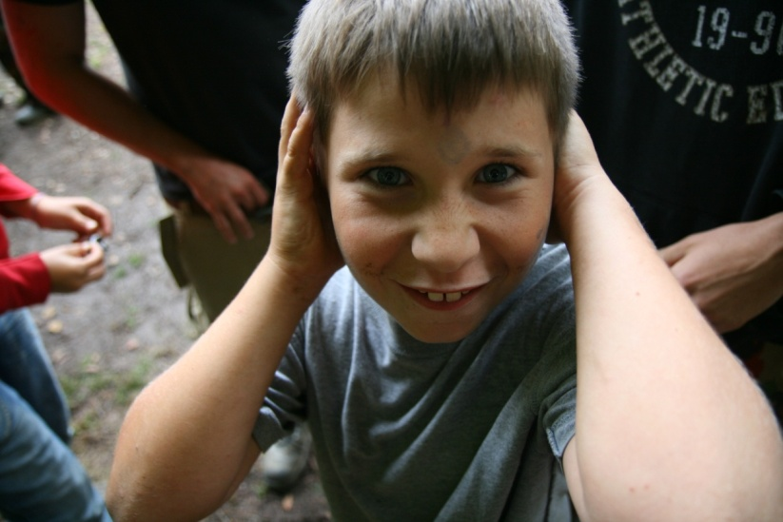
Associative Learning:
Classical Conditioning
Stimulus 1: See lightning
How it works: after repeated exposure to two stimuli occurring in sequence, we associate those stimuli with each other.
Result: our natural response to one stimulus now can be triggered by the new, predictive stimulus.
Stimulus 2: Hear thunder
Here, our response to thunder becomes associated with lightning.
After Repetition
Stimulus: See lightning
Response: Cover ears to avoid sound
Notes:
Click to start animated example (let it play out).
Instructor: another example of classical conditioning in which we learn from experience occurs when conditioning helps us associate “BEEEP” with an approaching car. The BEEP sound soon is as alarming as the car. Without this learning, cars might run us over.
Another example of classical conditioning: military service personnel who hear a mortar launch sound “thoom” followed by a violent explosion nearby may learn to associate those two stimuli. As a result, at fireworks, even when they know there is no danger, the launch of fireworks sometimes still triggers a “duck and cover” reaction.

Slide 7
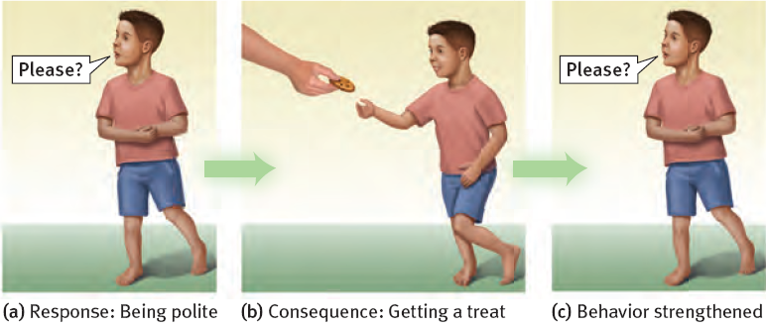
Associative Learning: Operant Conditioning
Child associates his “response” (behavior) with consequences.
Child learns to repeat behaviors (saying “please”) which were followed by desirable results (cookie).
Child learns to avoid behaviors (yelling “gimme!”) which were followed by undesirable results (scolding or loss of dessert).
Notes:
No animation.

Slide 8
Cognitive Learning
Cognitive learning refers to acquiring new behaviors and information mentally, rather than by direct experience.
Cognitive learning occurs:
by observing events and the behavior of others.
by using language to acquire information about events experienced by others.
Notes:
No animation.

Slide 9
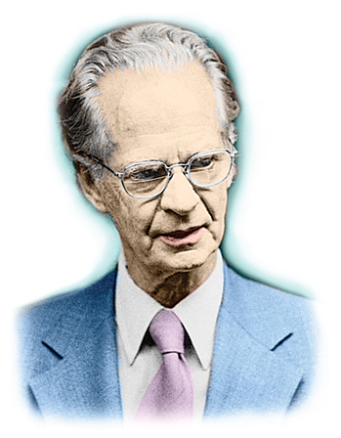
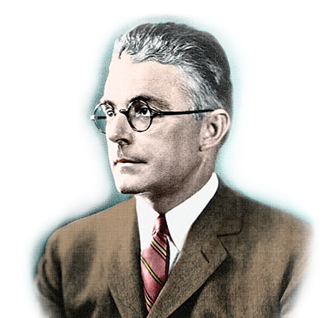
Behaviorism
The term behaviorism was used by John B. Watson (1878-1958), a proponent of classical conditioning, as well as by B.F. Skinner (1904-1990), a leader in research about operant conditioning.
Both scientists believed the mental life was much less important than behavior as a foundation for psychological science.
Both foresaw applications in controlling human behavior:
Skinner conceived of utopian communities.
Watson went into advertising.
Notes:
Click to reveal bullets.

Slide 10
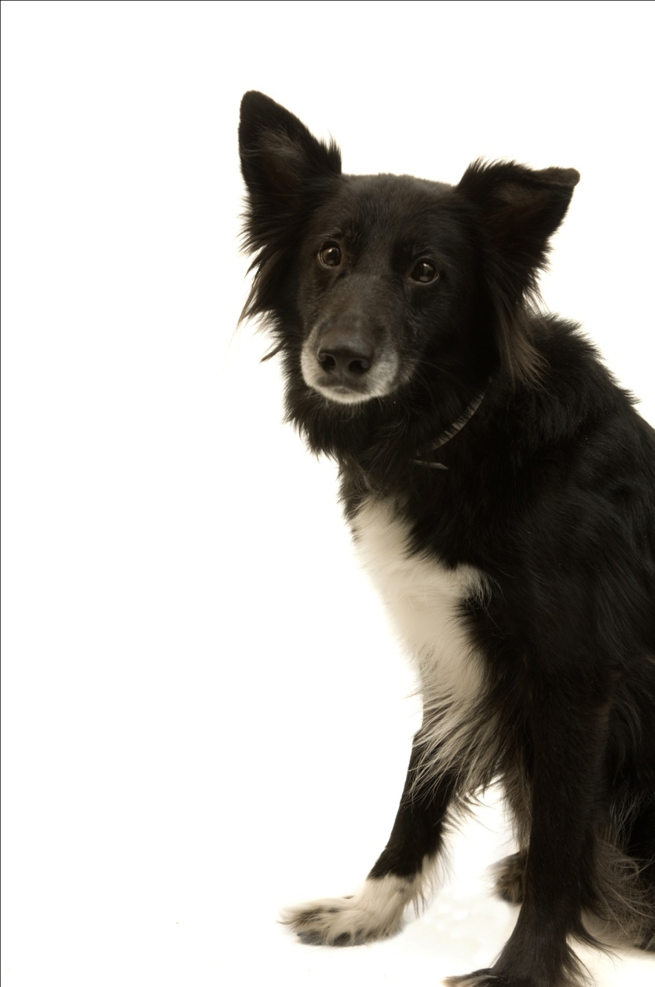
Ivan Pavlov’s Discovery
While studying salivation in dogs, Ivan Pavlov found that salivation from eating food was eventually triggered by what should have been neutral stimuli such as:
just seeing the food.
seeing the dish.
seeing the person who brought the food.
just hearing that person’s footsteps.
Notes:
Click to reveal bullets.
Instructor, you can add verbally:
“The dog had learned that these stimuli predicted the arrival food. These neutral stimuli had become conditioned stimuli.”
Ivan Pavlov then performed controlled experiments yielding much of the knowledge about conditioning still used today.

Slide 11
Before Conditioning
Neutral stimulus:
a stimulus which does not trigger a response
Neutral
stimulus (NS)
No response
Notes:
Click to start animation.

Slide 12
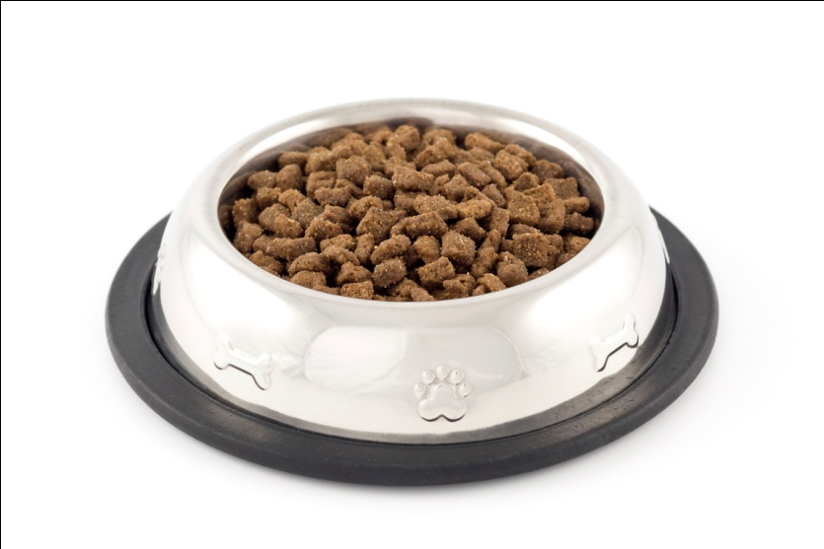
Before Conditioning
Unconditioned stimulus and response:
a stimulus which triggers a response naturally,
before/without any conditioning
Unconditioned response (UR):
dog salivates
Unconditioned
stimulus (US): yummy dog food
Notes:
Click to start animation.
Ivan Pavlov’s dogs exhibited salivation (UR) in response to food (US).

Slide 13
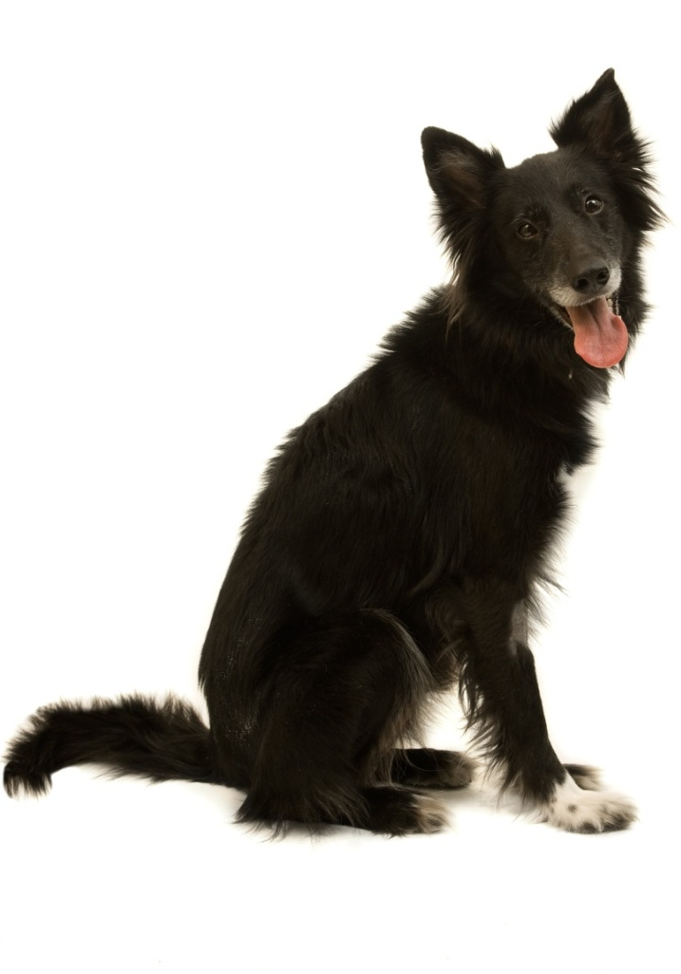
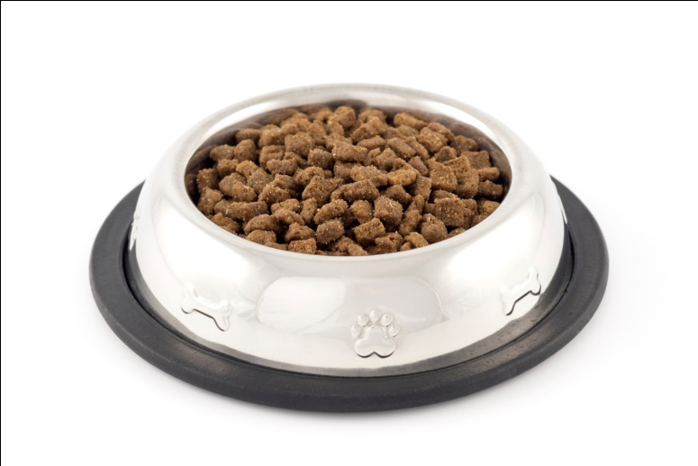
During Conditioning
The bell/tone (N.S.) is repeatedly presented with the food (U.S.).
Neutral
stimulus (NS)
Unconditioned response (UR):
dog salivates
Unconditioned
stimulus (US)
Notes:
Click to start animation.
Ivan Pavlov then presented a tone (NS) just before presenting the food (US).
APA Learning Goal 1: Knowledge Base of Psychology

Slide 14
After Conditioning
The dog begins to salivate upon hearing the tone (neutral stimulus becomes conditioned stimulus).
Did you follow the changes?
The UR and the CR are the same response, triggered by different events.
The difference is whether conditioning was necessary for the response to happen.
The NS and the CS are the same stimulus.
The difference is whether the stimulus triggers the conditioned response.
Conditioned response:
dog salivates
Conditioned (formerly neutral)
stimulus
Notes:
Click to start animation. Click again to show recap.
After a few pairings, the NS (tone) became a CS, and it was able to produce a CR (salivation) by itself.

Slide 15
Find the US, UR, NS, CS, CR in the following:
Your romantic partner always uses the same shampoo. Soon, the smell of that shampoo makes you feel happy.
The door to your house squeaks loudly when you open it. Soon, your dog begins wagging its tail when the door squeaks.
The nurse says, “This won’t hurt a bit,” just before stabbing you with a needle. The next time you hear “This won’t hurt,” you cringe in fear.
You have a meal at a fast food restaurant that causes food poisoning. The next time you see a sign for that restaurant, you feel nauseated.
Notes:
No animation.

Slide 16
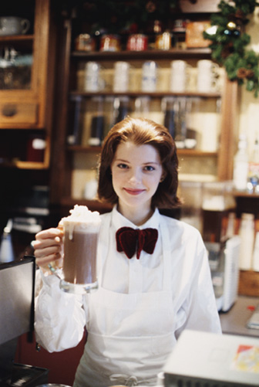
Higher-Order Conditioning
If the dog becomes conditioned to salivate at the sound of a bell, can the dog be conditioned to salivate when a light flashes…by associating it with the BELL instead of with food?
Yes! The conditioned response can be transferred from the US to a CS, then from there to another CS.
This is higher-order conditioning: turning a NS into a CS by associating it with another CS.
→A man who was conditioned to associate joy with coffee, could then learn to associate joy with a restaurant if he was served coffee there every time he walked in to the restaurant.
Notes:
Click to reveal bullets.

Slide 17
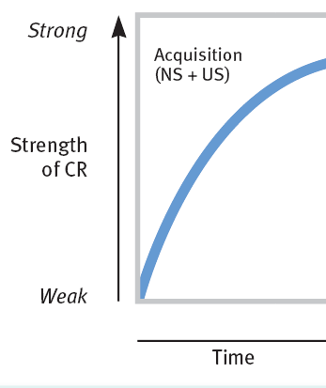
Acquisition
Acquisition refers to the initial stage of learning/conditioning.
What gets “acquired”?
→ The association between a neutral stimulus (NS) and an unconditioned stimulus (US).
How can we tell that acquisition has occurred?
→ The UR now gets triggered by a CS
(drooling now gets triggered by a bell).
Timing
For the association to be acquired,
the neutral stimulus (NS) needs to repeatedly appear before the unconditioned stimulus (US)…about a half-second before, in most cases. The bell must come right before the food.
Notes:
Click to reveal text boxes.
Instructor, some discussion prompts:
“In the “acquisition graph,” what does “strength” mean?” [Answer: it refers to the strength of the association between NS and US, as measured by the likelihood and intensity of the unconditioned response (drooling) now being triggered by the former neutral (now conditioned) stimulus (the bell). More drooling = more strength.
Timing issue: why wouldn’t it work if we rang the bell AFTER presenting the food?...because our bodies/brains are not set up to work that way. Why not?...conditioning allows us to prepare for benefits or threats; a bell after the food wouldn’t predict anything..
An exception to the half-second rule is food aversion, coming up in a later slide.

Slide 18
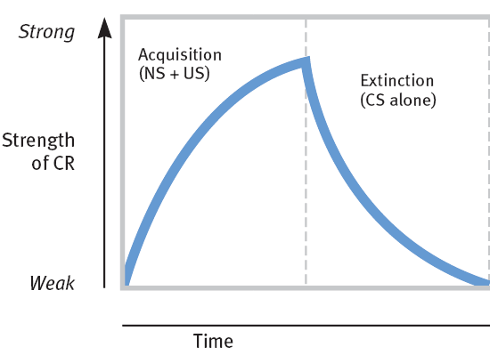
Acquisition and Extinction
The strength of a CR grows with conditioning.
Extinction refers to the diminishing of a conditioned response. If the US (food) stops appearing with the CS (bell), the CR decreases.
Notes:
No animation.

Slide 19
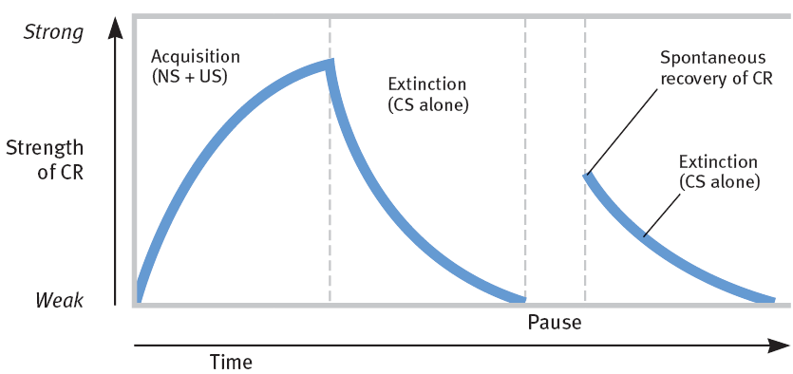
Spontaneous Recovery [Return of the CR]
After a CR (salivation) has been conditioned and then extinguished:
following a rest period, presenting the tone alone might lead to a spontaneous recovery (a return of the conditioned response despite a lack of further conditioning).
if the CS (tone) is again presented repeatedly without the US, the CR becomes extinct again.
Notes:
No animation.
Instructor: one implication of spontaneous recovery is that a behavior therapist may think that a phobic reaction has been extinguished, by repeatedly presenting the phobic stimulus without anything bad happening. However, after a rest from treatment, the phobic reaction can return. One solution is counterconditioning in order to build a new association.

Slide 20
Generalization and Discrimination Please notice the narrow, psychological definition .
Ivan Pavlov conditioned dogs to drool when rubbed; they then also drooled when scratched.
Ivan Pavlov conditioned dogs to drool at bells of a certain pitch; slightly different pitches did not trigger drooling.
Generalization refers to the tendency to have conditioned responses triggered by related stimuli.
Discrimination refers to the learned ability to only respond to a specific stimuli, preventing generalization.
MORE stuff makes you drool.
LESS stuff makes you drool.
Notes:
Click to show generalization and then discrimination sequences.
There are possible evolutionary values for each of these aspects of conditioning.
Generalization: if a leopard roars and then bites you, it might help you survive if you avoid other large cats who roar, and maybe the ones who growl too. → Abused children have been found to generally fear any angry face.
You also can apply your associations to related situations. If you get hurt by a Colt 45, watch out for ALL guns
Discrimination: if hearing your mother’s voice comes right before getting fed, it might help you to survive if you recognize and distinguish your mother’s voice from among a group of people. → Therapy can help anxious people stop having fears triggered by safe stimuli.
You learn to react only when it’s appropriate. For example you fear guns, but not someone pointing a finger at you, and you don’t develop an aversion to ALL food.

Slide 21
Ivan Pavlov’s Legacy
Notes:
No animation.
A different application of classical conditioning might include working with phobias...not just creating them, but eliminating them.
Exposure to a conditioned stimulus (such as a store where panic attacks have occurred) without the UR (the panic attack) can extinguish phobias. However, to prevent spontaneous recovery, counterconditioning must occur (associating the store with a relaxed state).

Slide 22
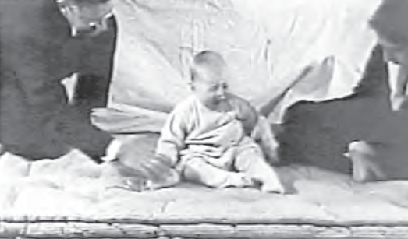
John B. Watson and Classical Conditioning: Playing with Fear
In 1920, 9-month-old Little Albert was not afraid of rats.
John B. Watson and Rosalie Rayner then clanged a steel bar every time a rat was presented to Albert.
Albert acquired a fear of rats, and generalized this fear to other soft and furry things.
Watson prided himself in his ability to shape people’s emotions. He later went into advertising.
Notes:
Click to reveal bullets.
A different application of classical conditioning would include working with phobias; not just creating them, but eliminating them.
Exposure to a conditioned stimulus (such as a store where panic attacks have occurred) without UR (the panic attack) can extinguish phobias, but to prevent spontaneous recovery, counterconditioning must occur (associating the store with a relaxed state).

Slide 23
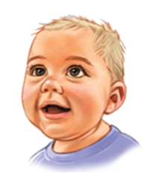
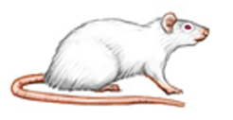
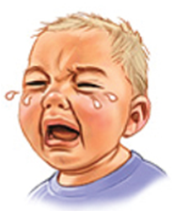
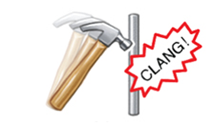
Little Albert Experiment
Before Conditioning
No fear
NS: rat
UCS: steel bar hit with hammer
Natural reflex:
fear
Notes:
Automatic animation (top half sequence).
Click to reveal bottom half sequence.

Slide 24
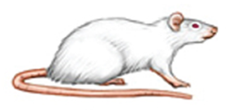
Little Albert Experiment
UCS: steel bar hit with hammer
NS: rat
Natural reflex:
fear
During Conditioning
Notes:
Automatic animation.

Slide 25
Little Albert Experiment
NS: rat
Conditioned reflex:
fear
After Conditioning
Notes:
Automatic animation.

