Slide 1
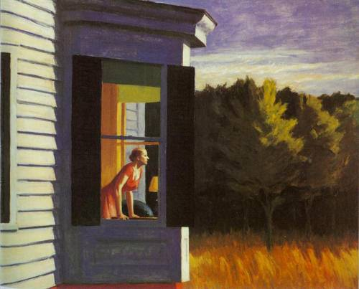
Edward Hopper
Great light source, look at the contrast in values. What color scheme is this? Can the environment add to the information about the person enhancing the “portrait”?

Slide 2
Ernst Ludwig Kirchner
Great example of complementary color usage and composition. What creates movement, unity, contrast?

Slide 3
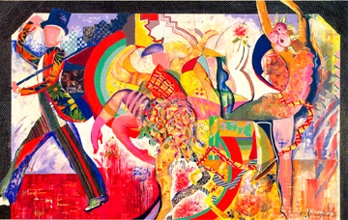
Mariam Schapiro
Is this a portrait? What carries your eye from one side to the other? Is this happy or sad, high or low energy? What tells you that visually.

Slide 4
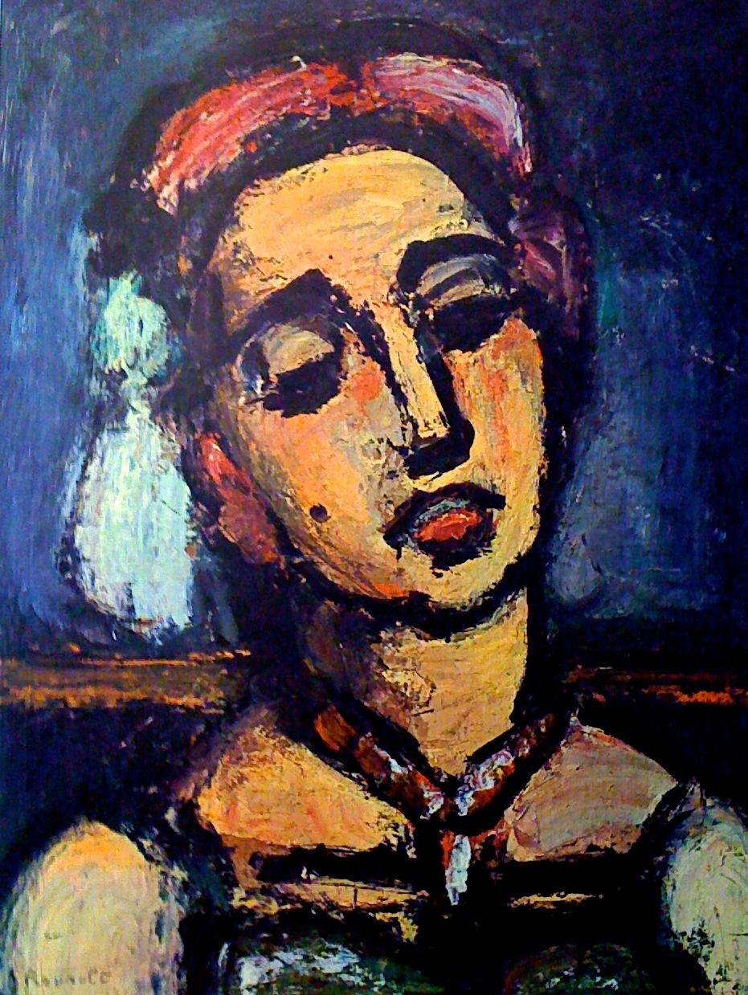
George Rouault
Notice the angle of the head. The back adds drama and contrast against the flesh tones.
What colors are used for the flesh tones?

Slide 5
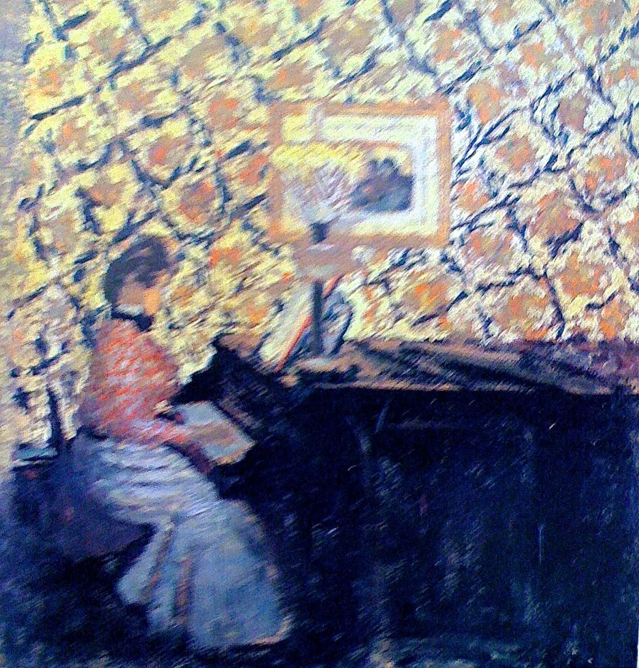
Notice the pattern of the wall paper and how it creates a repeated pattern and rhythm.
Edouvard Vuillard

Slide 6
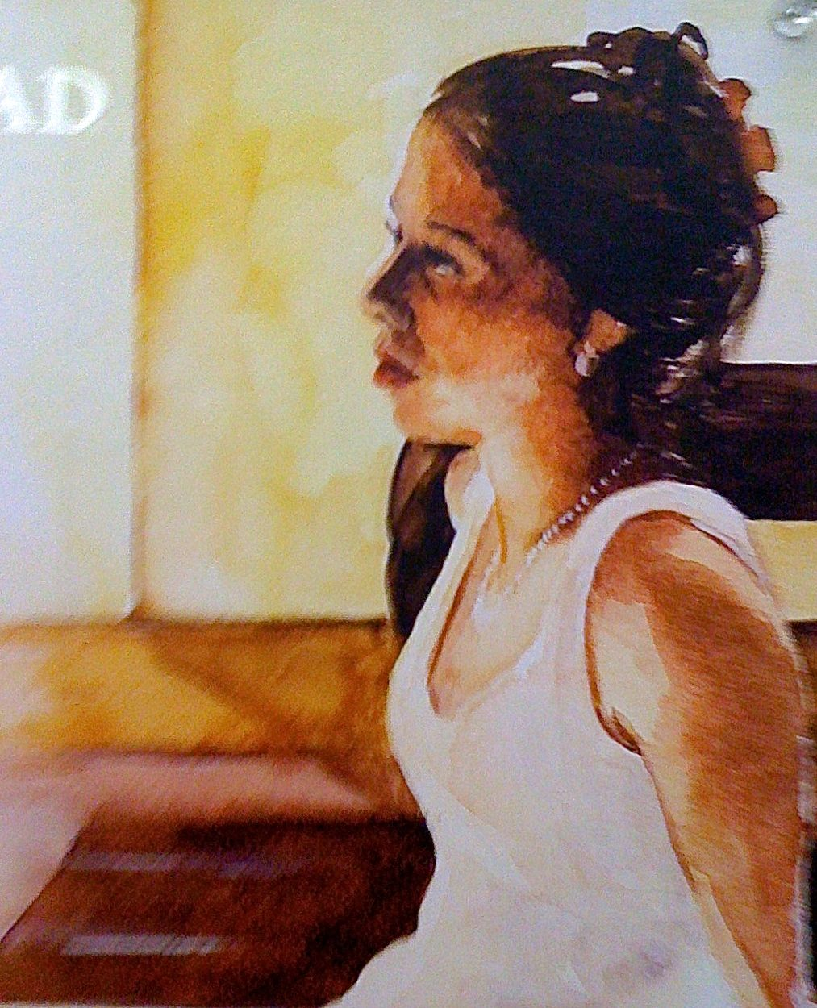

Slide 7
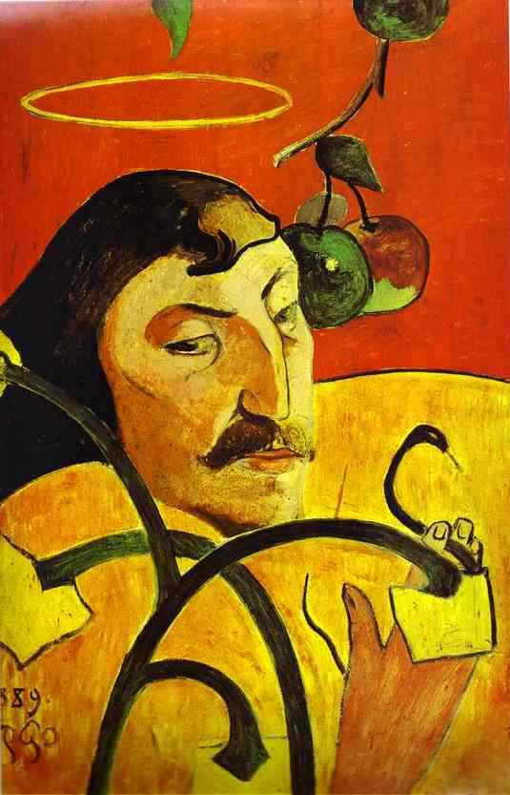
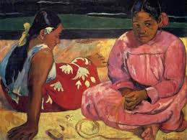
Use of color and values of colors is strong.
How important is line in the self portrait?
Paul Gauguin

Slide 8
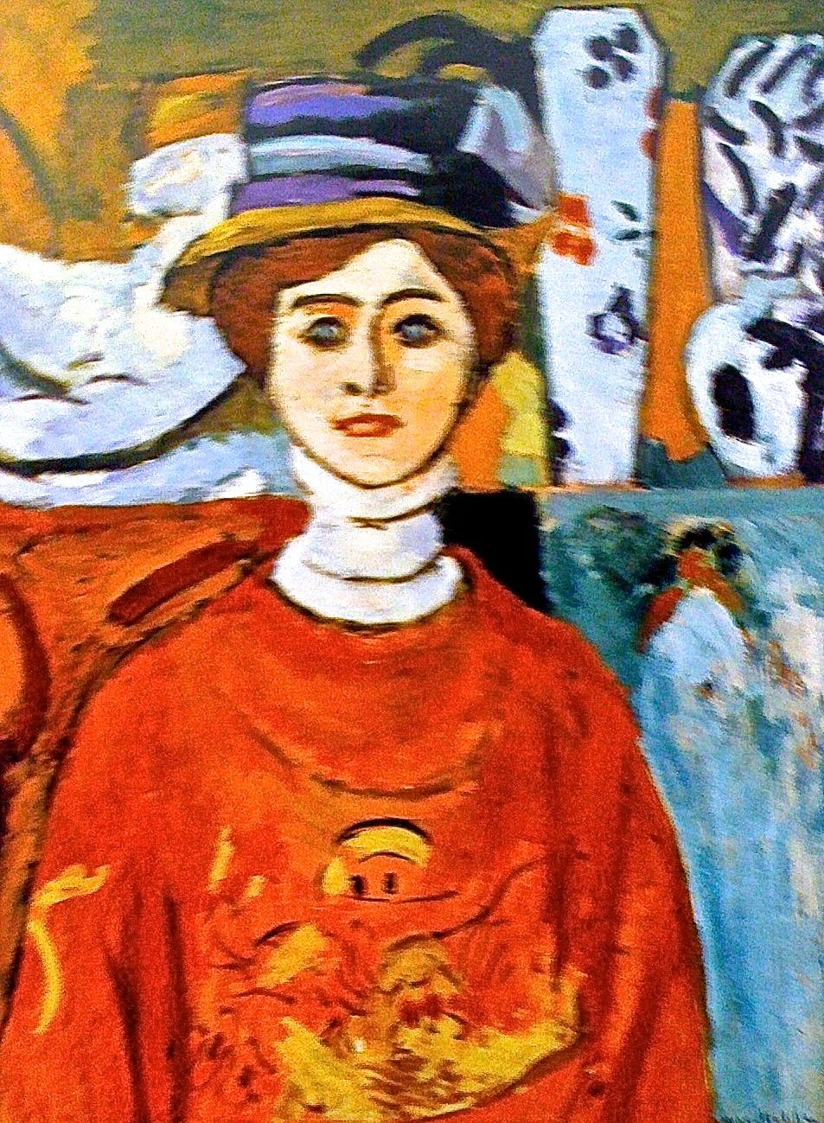
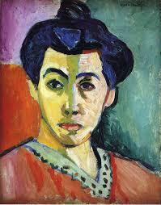
High contrast and use of color & values to indicate light source.
Background is as interesting as face. Use of line is strong
Henri Matisse

Slide 9
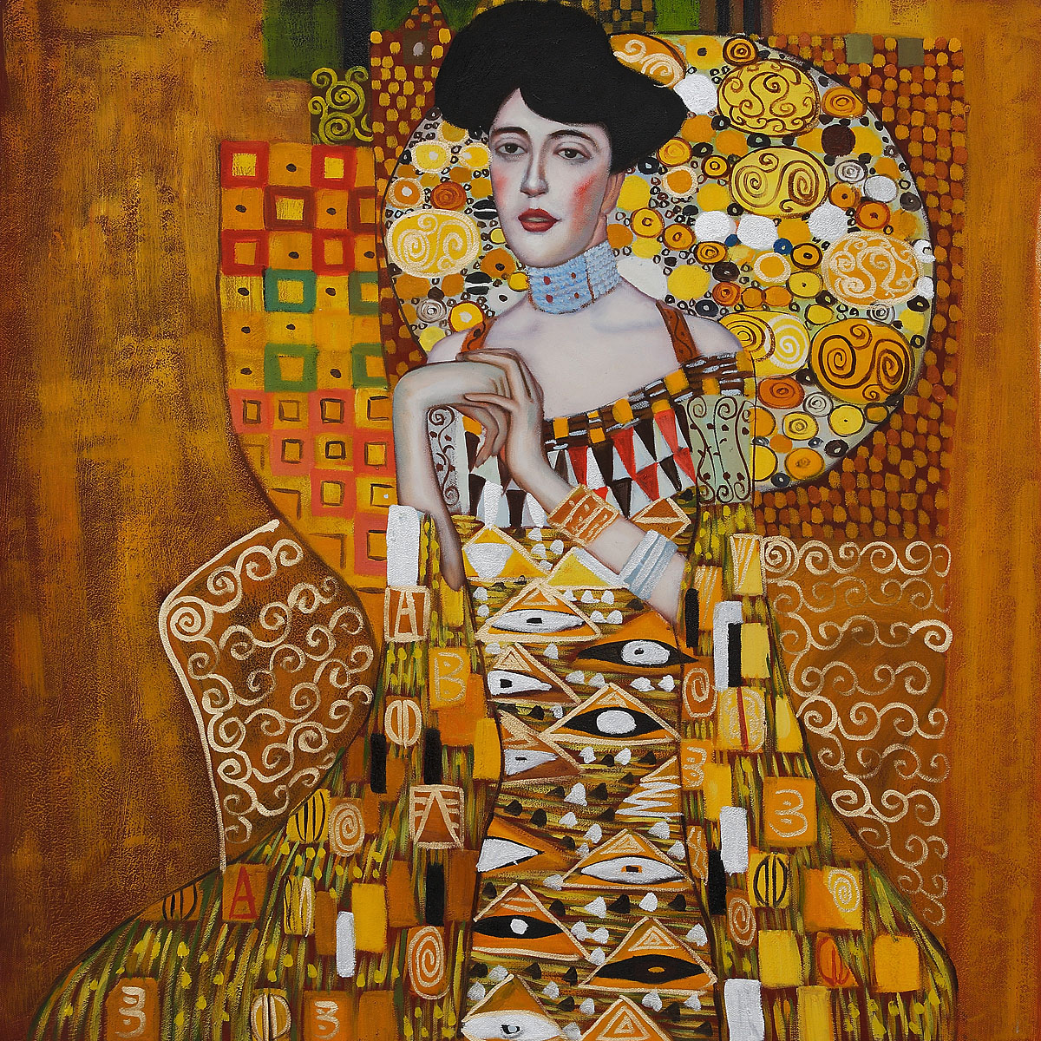
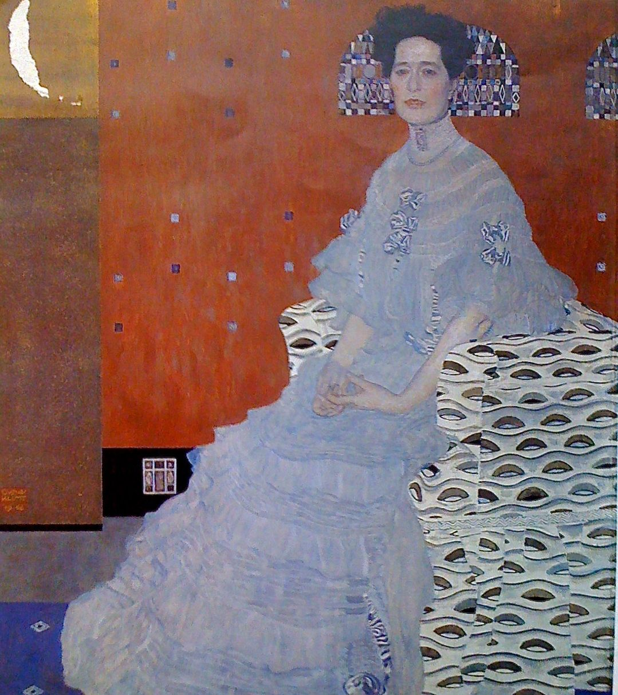
Stylized realism with pattern, abstraction, texture, repetition, rhythm.
Gustav Klimt- look up more work and the time frame of his work.

Slide 10
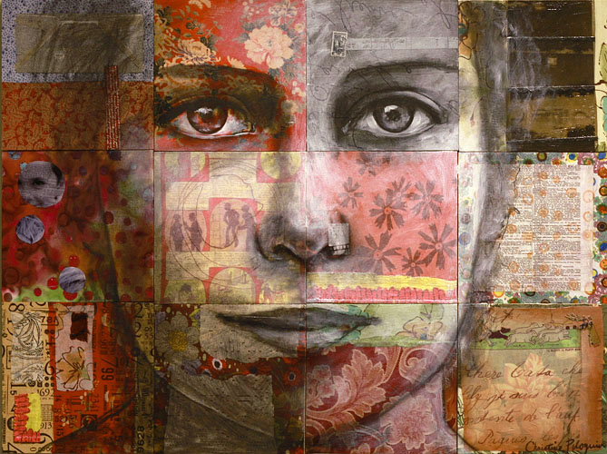
www.christinepeloquin.com
Portrait and patterns - What is 3-D form and what is flat? Transparent layers can be painted or created in Photoshop.

Slide 11
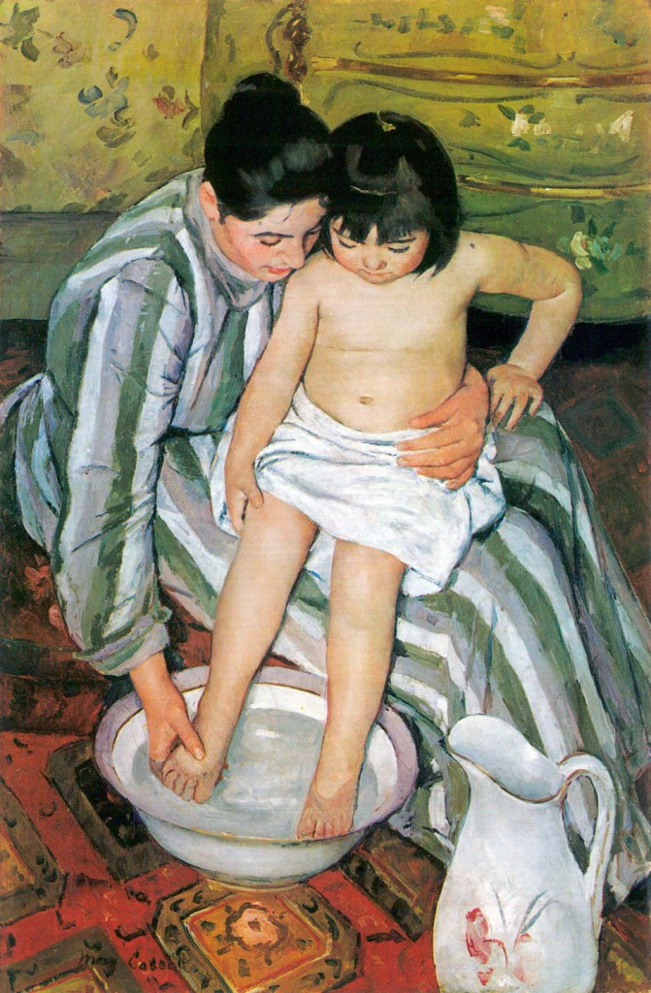
Mary Cassatt
Notice the composition in terms of
Movement and unity. Your eye moves through and stays in the painting. Track you eye movement.
Where does it go?
How many diagonals can you find?
Back ground is interesting with colorful patterns. Where are the detail and where is it painted loosely?

Slide 12
1. Decide which 4 styles you want to use.
2. Make some thumbnails of ideas.
3. Find a model or photo references to work from
4. Plan each piece so you are using a different media for each. (Remember media
can be combined in different ways.
5. Think about the background, the clothing, the transparent overlays, the
position of the person and how it informs the viewer about who that person is.
6. Give yourself enough time to enjoy the process and product of your art making.
Time yourself on the first one to know how much time you may need.
7. All 4 portraits are due the first day you return for 2nd semester, Jan. 7th.

Slide 13
Rubric for each of 4 portraits
Portrait shows thought and time well spent to create image. 10
Composition is good in terms of movement and unity 10
Use of media is skillful and inventive. 10
4. Negative and positive space are used well and add to the
Feeling of who this person is or what they might be like. 10
5. 4 styles from samples and 4 different medias are used creatively. 10

